Slide 1
COMMON AGRICULTURAL POLICY
Future CAP and its implications for agricultural advisory services
Inge Van Oost
Senior Expert EU AKIS coordination
25 June 2026
Greek advisors - online
^{CAP 2028-2034}

Slide 2

1. AKIS Strategic Plans in the CAP 2023 + post 2027
Expectations from EU CAP for advisors:
1) Competent advisors and a broad scope of advice
2) Central role + including new roles within the AKIS

Slide 3
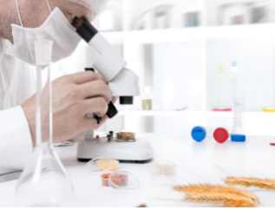
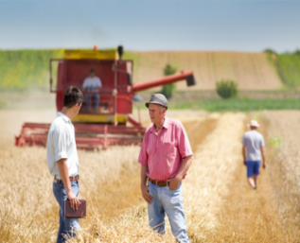
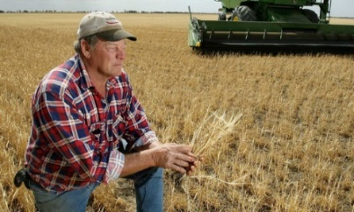
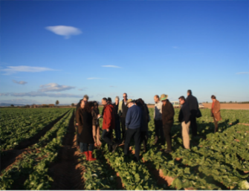


Agricultural Knowledge & Innovation System: What is AKIS? Why AKIS?
AKIS = Systemic approach, focused on creating innovation ecosystems and on how knowledge is generated and disseminated, in agriculture and beyond (Art 114 R.2115/2021)
Strengthening synergies between AKIS actors & actions
AKIS
Researchers
Advisers
A good AKIS strategy will bring actors together on a structured and regular basis, creating continuous interaction to speed up knowledge exchange, knowledge flows, innovation and most of all: implementation in practice
Education
Farmer
at the centre of the integrated Agricultural Knowledge and Innovation System (AKIS) to support modernisation, innovation and knowledge flows
Businesses
Organisations
Media
Source: Inge Van Oost, EC, DG AGRI, Regulatory requirements and the EU support in CAP for advice and advisors integrated within AKIS
Notes:
Systemic approach, focused on creation innovation ecosystems and on how knowledge is generated and disseminated

Slide 4
Having potential innovative knowledge is one thing, turning it into reality is another.
"The value of an idea lies in the using of it."
Thomas Alva Edison – inventor of the light bulb

Slide 5
AKIS strategy description as requested in CAP plans 2023-2027 section 8 (R. 2021/2289)
  8.1. Overall organisational set-up of the AKIS
  Explain your overall AKIS strategic approach based on the SWOT and assessment of needs outlining how the interventions and actions will work together
  8.2. How will advisory services, research, CAP networks and interventions work together within the framework of the AKIS?
  An explanation of the organisation of the collaboration of advisors, researchers and CAP networks.
  8.3. Description of the organisation of farm advisors
  Clarify how the delivery of advice is organised, integrating all advisors
  8.4. Description of how innovation support is provided
  Clarify how Innovation Support Services within the AKIS are organised.

Slide 6
How to draft a coherent AKIS strategy?
=> strengthening synergies between interventions/actions
EIP OGs
Education & Training
On farm demo
Advice
Note: The chosen interventions are just an example, many others are useful
Knowledge exchange

Slide 7
Main AKIS interventions supporting advisors within the CAP 2023-2027
  Farm advice (financing for farmers/foresters) by farm advisors
  Training and lifelong learning (financing for farmers/foresters, lead by advisors as well as training for advisors)
  Knowledge exchange and information dissemination (trainings, on-farm demonstration, discussion networks, information activities, etc.) where advisors play a key role
  EIP-AGRI operational group projects (bottom-up innovation projects including as much as possible advisors as coordinator or as partner)
Farm advisors’ integration in the AKIS: how and why?
Sustainable CAP and state financing to be secured (Art 78, 127)
  Advisors to be integrated in the AKIS to cover economic, environmental and social dimensions and to deliver up-to-date technological and scientific information developed by R&I . Support needed for advisors to do so
  Impartial advice and provision of innovation support to capture bottom-up grassroots ideas, e.g. for preparing and implementing EIP OG Operational Group projects
  Fostering farm advisors’ competences and knowledge: obligatory regular training for advisors, connecting to (thematic) knowledge reservoirs

Slide 8
  After the radical reshaping of CAP Advice support in 2023: Where do advisors fit in, to help AKIS knowledge flows?
  Member States should work with advisors to strengthen the AKIS. Advisors can be now be rewarded beyond payment for advice (“new business models”):
  Farm advice financing for farmers/foresters by advisors
  Training and lifelong learning lead by advisors as well as training for advisors
  Knowledge exchange and information dissemination (trainings, discussion networks, information activities, thematic knowledge hubs etc.) where advisors facilitate. Advisors are perfect intermediaries!
  Advisors providing innovation support to capture grassroots innovative ideas, e.g. for preparing and implementing EIP OG Operational Group projects (“innovation support services” ISS)
  EIP-AGRI Operational group innovation projects including as much as possible advisors as coordinator or as partner
  Advisors to be integrated in the AKIS to cover economic, environmental and social dimensions and to deliver up-to-date technological and scientific information developed by R&I . Support needed for advisors to do so (e.g. in advisory back-offices, or in thematic knowledge hubs)
  Fostering farm advisors’ competences and knowledge: obligatory regular training for advisors, connecting to (thematic) knowledge reservoirs

Slide 9
      Promote the use of the national advisory database, to help farmers to find the most competent advisors for a specific subject and spend CAP budget in an impactful way
      Create advisory networks, where advisors can share experience & can learn from each other
      Providing a mobility budget for advisors to go on cross-visits abroad and share the novel information when coming home
      Face-to-face thematic events, where all AKIS actors meet and share information. Demonstration events are perfect, as well as winter meetings;
      On-farm demonstrations/trainings led by advisors, so that they incentivise their clients to join and ensure that the demonstration/training is sufficiently applicable and attractive for farmers
      E-learning, podcasts, etc for advisors tools help advisors in their work with clients to showcase certain topics, examples or share information/training elements
      Train advisors on OG outcomes: training can specifically take in OG outcomes and invite OG partners to training events
      Make advisors/trainers provide services for OG projects, let them support the events and on-farm demonstrations: if they are convinced, so will be their clients!
      Mediator in regulatory issues (new role): share knowledge and experience on implementing farmer rules in practice (Blix Germundsson 2026), policy interface – see IE OG projects

Slide 10
COM guidance on Advisory activities (April 2024)
      To ensure advisory services are effective, advisors must be impartial, competent and give well-tailored individual advice.
      Therefore, all Member States are expected to develop a national public database of all impartial advisors, as a means to give a transparent view on the availability of advisors, their expertise and education.
      Such database gives farmers the freedom to choose their public or private advisor based on objective information and ensures the highest possible impact of the CAP funding invested in advice.
      This includes also their Life-Long Learning, as advisors should follow the obligatory training for advisors, which the MS must organise according to Article 15(3). The database should of course also indicate if the advisor has followed this training.
      Specific certification procedures are not needed and may reduce the number of advisors available and visible in the database. In the end, it will be market mechanisms which will help single out the best impartial advisors, most appreciated/trusted by farmers.

Slide 11
Advisory activities: COM guidance April 2024
      “Keeping in mind the broad scope in which advisors can play a role, a few innovative approaches in improving effectivity of advisors are listed below as examples already applied in some Member States’ CAP plans:
      - Handing over virtual vouchers directly to farmers to ensure the advice is more demand driven and meets the specific question of the farmer;
      - Providing practical info in knowledge reservoirs which focus on practical outputs. This helps advisors to get up-to-date information to share with their clients;
      - Set up public back-offices (thematic “knowledge hubs”) where specialist advisors are closely linked to respective science, collect all thematic knowledge available, thus helping any question a field advisor may receive from his clients. Such specialist advisors may join the field advisors in their work in the field where useful;
      - Promote the use of the national advisory database to help farmers to find the most competent advisors for a specific subject and spend CAP budget in an impactful way;
      - Create national advisory networks, where advisors can share experience, feel supported and can learn from each other;

Slide 12
Advisory activities: COM guidance April 2024
      - Providing a mobility budget for advisors to go on cross-visits abroad and share the novel information when coming home;
      - Face-to-face thematic events, where all AKIS actors meet and share information. Demonstration events are perfect, as well as winter meetings;
      - On-farm demonstrations/trainings led by advisors, so that they incentivise their clients to join and ensure that the demonstration/training is sufficiently applicable and attractive for farmers;
      - E-learning, podcasts, etc for advisors’ training. Such tools could also help advisors in their work with clients to showcase certain topics, examples or share information/training elements.
      Almost all these innovative advisory formats can be supported under Article 78, and some under Articles 77 and 127 (Operational Groups), or technical assistance. The Commission Services are ready to help Member States to devise dedicated interventions in this regard.”

Slide 13
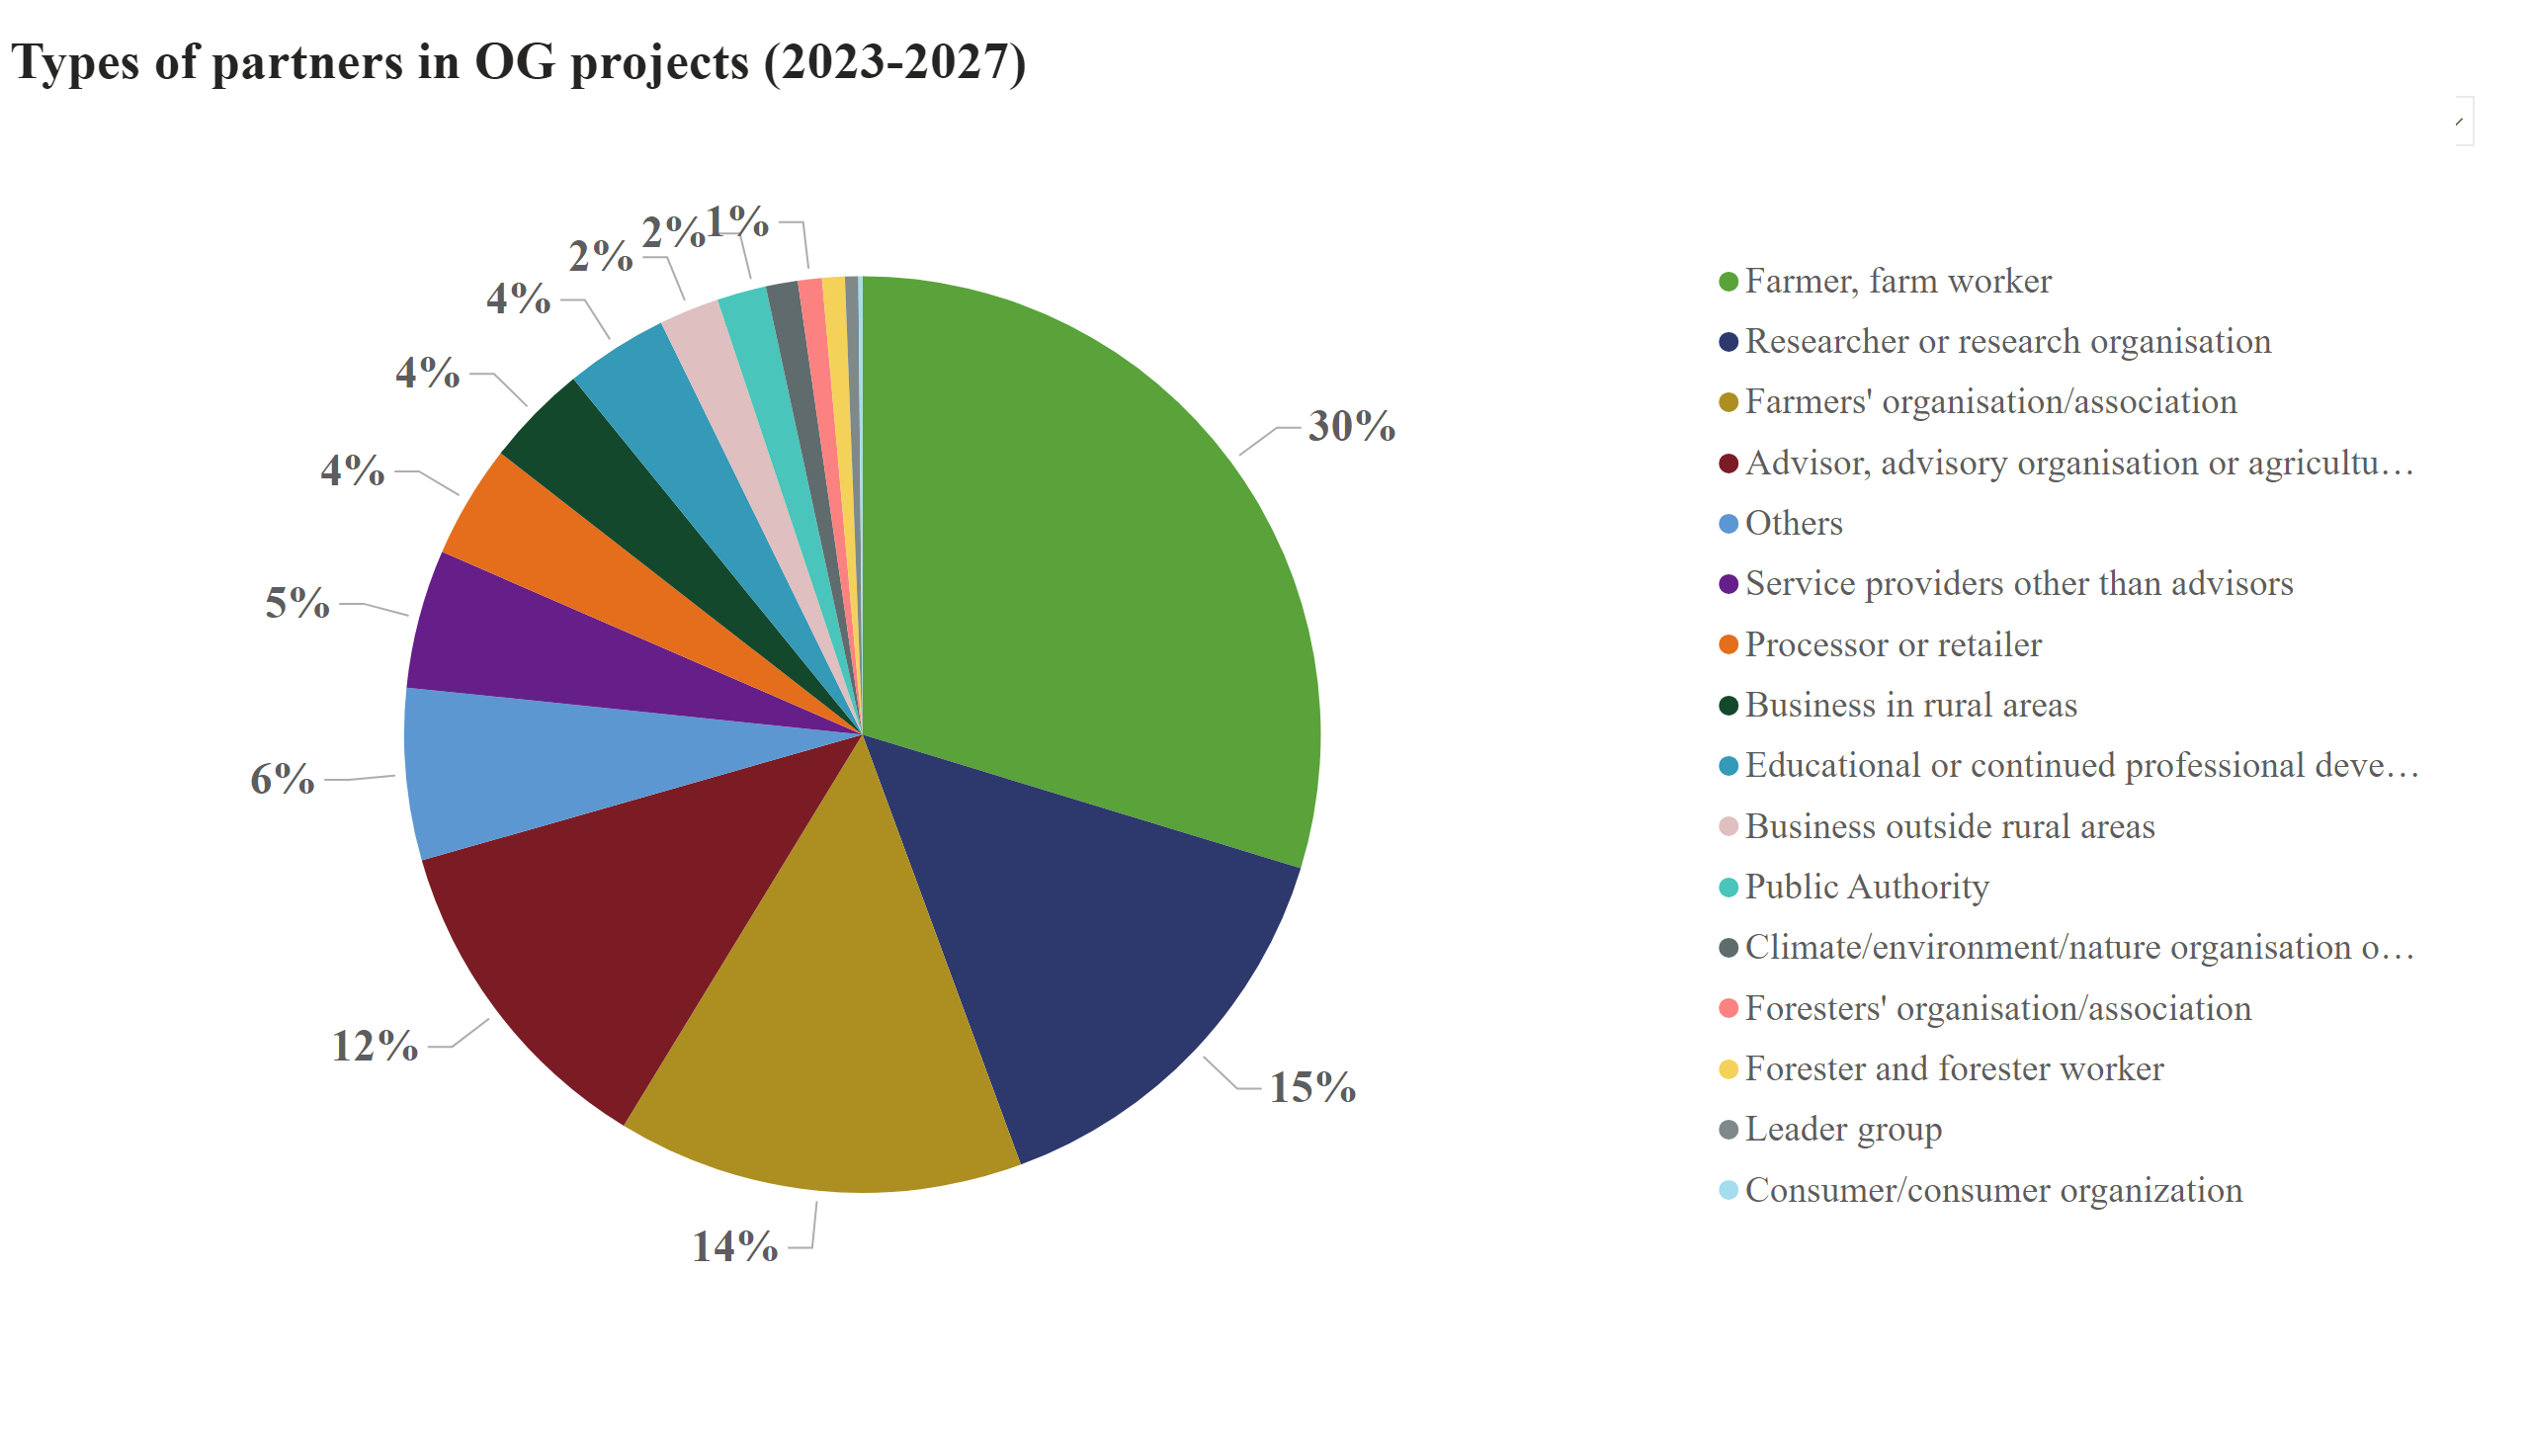
Partners
We are happy to observe an increase in advisors' participation in EIP-OG projects from 10%-12% at the start of the former CAP 2014-2022 to
17-19 % advisors now already take the role as Lead partner (coordinator) !

Slide 14
To complete the innovation networking ecosystem in the new CAP: a new obligation for all MS to organize individual innovation support services (ISS)
We appreciate synergies but keeping the difference between the following 2 approaches is essential:
1) individual “innovation support services” (as in some MS already funded in this period, activities more oriented to the individual idea owner to help its emerging OG, mostly done by advisors)
2) broader “innovation networking” by the CAP networks/NRNs/regional innovation networks as already is happening in this period: are more group actions to incentivize innovation, support calls, bring together AKIS actors etc
  Do not underestimate the efforts and budget needed for individual ISS (3.000 -8.000 Euro per project, lump sums by preference)

Slide 15
2. European survey on what advisors need and expect in the future CAP

Slide 16
How do advisors see the value of their integration into AKIS?
An EU wide survey by the ModernAKIS project
Advisors feel the following elements to be (very) important :
  Training opportunities
  Cooperation in AKIS
  Access to research results within AKIS
  Networking to support involvement in AKIS: at conference & workshops, in projects, at regional meetings, in excursions, in cross-country visits, through personal exchanges, help for their methodological skills used in farm advising
  Rather not important (yet): networking through digital platforms (maybe not the right tools are available yet?). E.g. EU Farmbook may help a lot thanks to AI search and translation
  Key sources of knowledge for advisors: exchange with colleagues, specialist meetings, face to face, online events, continuous training organisation, journals. Some newer formats in the graphs are not yet much applied and may become important in the future
Source: modernAKIS/IALB/EUFRAS Advisors Survey, 2025 (Total of 974 respondents), detailed graphs can be seen in the annex

Slide 17
3a. Examples of how Member States work with advisors strengthening the AKIS & of how advisors can be rewarded beyond payment for advice (“new business models”):
Irish advisors are essential in OGs to prepare CAP measures

Slide 18




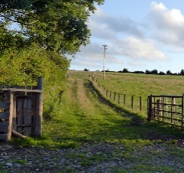
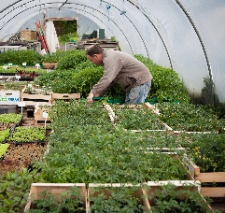
Irish EIP-AGRI OGs Breakdown - ‘Family of Measures’
Themed – Hen Harrier Project = €25m
Themed – Pearl Mussel Project = €10m
Open Call – Environment = €20m
Open Call – General = €4m
Agreed with Commission as part of Ireland’s RDP 14-20
Recruited by competitive tender
Responsible for developing local partnerships & actions
‘Bottom-up’ Operational Group Call
Recruited by simple application process
Designed to be accessible to all

Slide 19
Advisors can play a key role for developing policy measures:
  Irish OG projects preparing for future CAP measures thanks to intensive use of advisors’ knowledge and influence to reach the goals of the project.
  First two 2014-2022 OGs on the conservation of the Hen Harrier (25 mio €) & the Freshwater Pearl Mussel (10 mio €) now have been developed into the 2023-2027 CAP ACRES scheme: locally-led, farmers’ centered and result-based turned out to be a huge success
  2023-2027: implementation more big OGs on water catchment management, breeding waders etc
  Advisors are instrumental in convincing farmers to join the project, and later to support the CAP measure
  Advisors receive intensive training on biodiversity matters thanks to the project
  Training material for advisors and farmers is made: e.g. scorecards and booklets to help determine good and bad weeds
  The new « ACRES » agri-env-clim CAP intervention was developed based on the feedback of farmers and advisors to be easy to access and use
  Similar OGs arose in the NL, DE etc and the usefulness is widely acknowledged

Slide 20
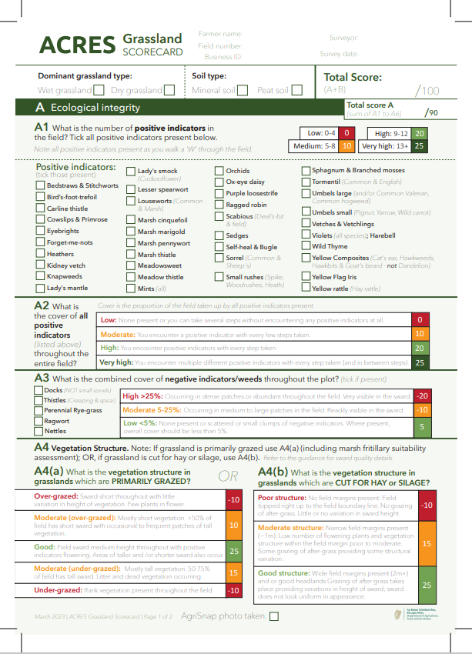
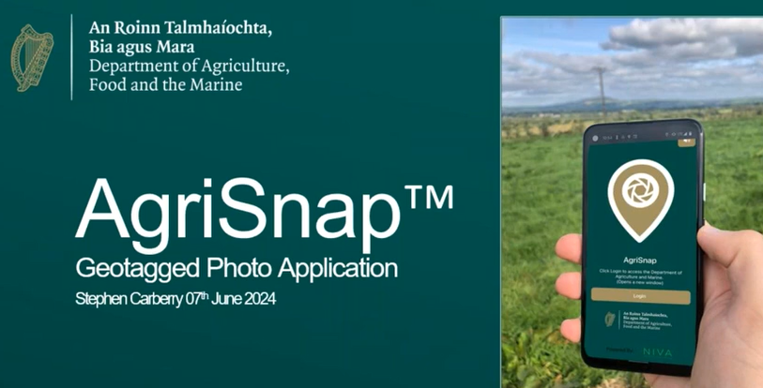
  Use of modern IT tools as well as paper based advisory scorecards: advisors’ influence and trust from the farmer are key for the results
  2023-2027: Result from OGs: a new CAP agri-env-clim intervention was developed (CAP « ACRES » intervention). It is supported by advisors who were previously trained under the EIP OGs 2014-2022 (+ training farmers on AECM)

Slide 21
3b. Examples of how Member States work with advisors:
NL: national advisory database of private advisors evolves into CAP advisory vouchers and LLL for advisors

Slide 22
  NL: History leads to challenges and privatized advisory
  The current Dutch system is private because policy reforms (1990) pushed for market-driven services and reducing state expenses
  The old public advisory service privatized and adapted to the new situation:
    Focus on individual advice, periodic visits at better farms (= niche of strongest commercial farms (horticulture, arboriculture), able to pay for top quality technical advice)
    All overhead and discussion time cut out
    with mixed payment: farmers and projects
  Suppliers (private and cooperative) took over most frequent advice in crop management, seed, fertilizer use, feeding and machinery. This advice is ‘free’ (paid in the product/knowledge mix).
  Economic aspect is key: Farmers want to pay for advice that brings in money, not for advice on sustainability and society (environment, climate, nature, etc). Advice on sustainability themes is provided by separate advisors (project experts)
  Challenges: Leading to fragmentation among advisors (no back-office) and other stakeholders who work with farmers, and limited integration of sustainability aspects in the total farm management
  SABE (Agricultural Advisory and Education Subsidy Scheme, nationally funded) helped to overcome some of the disadvantages of a largely privatised and fragmented advisory system and provides independent advice

Slide 23
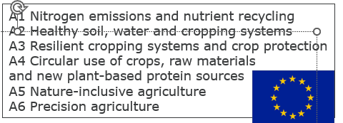
  NL: Further developed Dutch Farm Advisory quality system
  National advisory database and CAP advisory vouchers
  2013: Requirements for farm advice in CAP/RD Programmes introduced:
    Overview/registry of independent (“impartial”) advisors
    Quality improvement / lifelong learning of advisors
  Association of Independent Advisors (VAB) started the Business Advisory System (BAS) registry
  on voluntary basis, in an integrated system:
    The public registry shows the accreditation level/ type of expertise, impartiality
    For accreditation, the advisor needs continued lifelong learning (LLL) points (PE permanent education).
    VAB assesses trainings and meetings on content, relevance and skills
    Meetings and trainings are assessed on quality to assign PE points on specialist knowledge
    Education at least BSc + LLL
    BAS is required to cash CAP advisory vouchers
  CAP advisory vouchers: Individual advice from a certified advisor to the farmer
  Limited themes focusing on Sustainable entrepreneurship =>
  Each advisor has an interview,
  assessing BAS skills and knowledge level:
    Strategic: develop a sustainable vision for a farm
    Tactic: translate vision to concrete targets, priorities and practical implementation steps

Slide 24
  NL: Advantages and challenges: moving to the
  national advisory database and CAP advisory vouchers
  Positive effects of the advisory quality system & database:
    Advisors can be found (by farmers, colleagues, etc)
    Advisors improve themselves in meetings and trainings (LLL)
    Meetings and trainings for advisors reach optimal quality with
      Quality check (and suggestions) by independent PE commission
      Thanks to PE points, meetings and trainings have more advisors attending
  Challenge in Farm advisors’ quality system: FINANCIAL INCENTIVE
    Advisor: “There was no obligation to be in the BAS registry, it was ‘just’ a badge of professionality.”
    Ministry perspective: More advice on sustainability was needed, with good quality
  Win-win: Ministry developed a Farm advice voucher system (CAP supported), using BAS register:
    Ministry opens call on specific challenges, payment of €1500 (80% of total costs) per call.
    Farmer opens a voucher for one of these themes
    Farmer selects an advisor from the BAS registry (provided by VAB)
    Farmer assigns the voucher to an advisor, advisor cashes the voucher at the Ministry
  In addition, advisors get Training voucher €1250 (50% of training costs). Specific trainings are developed by Universities of Applied Science, together with advisors and top-level farmers.

Slide 25
3c. Examples of how Member States work with advisors:
BE Fl offers knowledge vouchers to farmers for advice and training, all advisors + all topics can profit

Slide 26
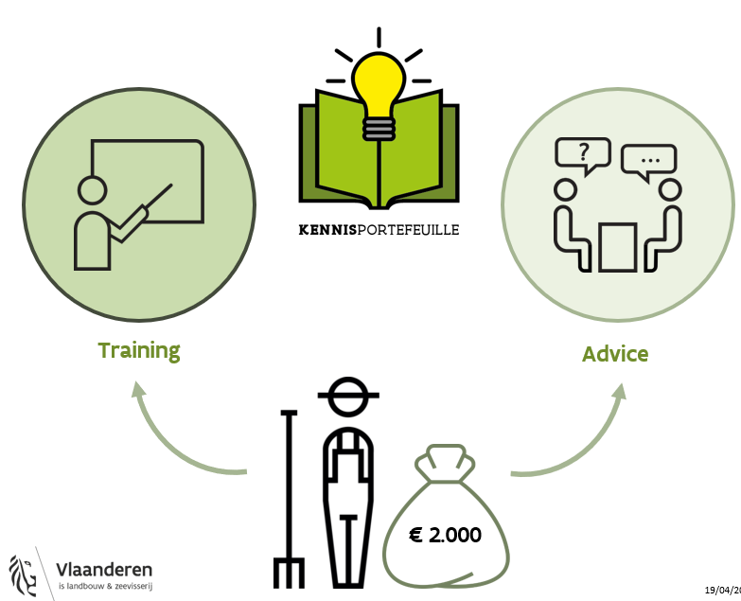
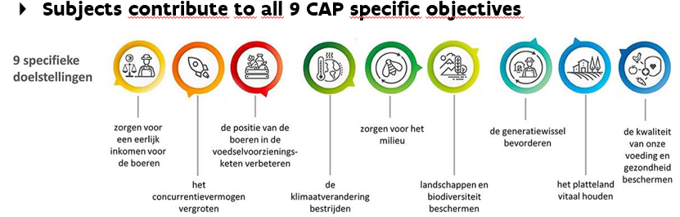
*2500 Euro in next year

Slide 27
  BE Fl: “Knowledge e-wallet”: demand driven approach
  Voucher system for training and advice
  Web application through which farmers can obtain aid supporting their further professionalisation
  Fixed budget that farmers can spend on advice and/or training during a certain period
  Advice: one-to-one targeted advice, tailored to the farm (groups can also ask advice and share cost)
  Provision by registered service providers = advisors and trainers (can subcontract if needed)
  Farmers free to choose their preferred service provider, the farmer activates the voucher => demand driven support. Providers will have to demonstrate they are delivering high quality services for a reasonable price, market/competitive forces improve ratio price/quality compared with public advisory.
  Offer on all ecological, economical and social topics (most popular are climate scan, energy advice, impact habitat rules – N emission, new business models and generational renewal)
  Criteria for registration of service providers (self-check on basic criteria below + audit each 5 years):
    Activity: professional approach of the organization (e.g. decent project filing, listening and analysing the requested advice, correct registration of demand and hours delivered, invoicing system, appropriate infrastructure according to needs…)
    Experience: knowledge and skills needed to provide services : the specific expertise is in house or may be hired in
    A system is used to measure customer satisfaction (after negative audit corrective measures to be applied)
    Integrity: service providers comply with laws and regulations
    Advisors have no conflict of interest and are impartial

Slide 28
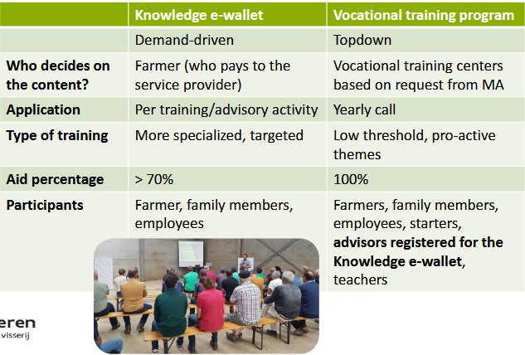
  BE Fl: Training support under CAP combines 2 interventions, one demand-driven and one organized topdown

Slide 29
4. AKIS Strategic Plans in the CAP post 2027
Small evolution => no revolution

Slide 30
AKIS in CAP post-2027: small evolution, not revolution
  The new articles on knowledge sharing and innovation are a continuation of the current regulation with continued emphasis on well-functioning Agricultural Knowledge and Innovation Systems.
  Concentration of knowledge and innovation in 2 key articles (CAP Art. 19 and 20), replacing current 5 articles spread over the CAP regulation
  Support for the preparation and implementation of EIP-AGRI operational groups and for knowledge sharing (Art.19) – current Art. 77, 78 and 127
  Provisions on Agricultural Knowledge and Innovation System (AKIS) to support innovation and knowledge sharing in a systemic and integrated way (Art. 20). Member States need to ensure provision of advice & transparency on advisors – replacing current Art. 15 and 114
  CAP networks activities continued under NRP Art. 57 - replacing current Art. 126: objective/tasks again to foster innovation, peer-to-peer learning and knowledge sharing, build capacity and network OGs

Slide 31
AKIS in CAP post-2027: Impact to be expected
  1. Improved understanding building on:
    Experience from the first AKIS strategy period 2023-2027: Understanding of Authorities has clearly improved and is further improving as time goes by and more and more AKIS actors become fully involved. How to build a good strategy: various EU AKIS seminars (2020, 2023 Vilnius, 2024 Tallinn, 2025 Reims, …) and at national level (e.g. DE Hannover Nov 2025),…
    2020 EIP Seminar on AKIS strategies in CAP Strategic Plans was recorded and can be seen again: https://ec.europa.eu/eip/agriculture/en/event/eip-agri-seminar-cap-strategic-plans-key-role-akis
    Exchange of best practices of EIP innovation projects: now already > 5100 OGs, CAP networks really active on innovation and knowledge exchange, connecting OGs across borders,…(Baltic cross-border OGs: LV+EE+FI)

Slide 32
AKIS in CAP post-2027: Impact to be expected
  1. Improved understanding building on:
    Exchange of best practices in Horizon MA projects: Thematic Networks, Advisory Networks, I2Connect, ModernAKIS, ATTRACTISS, EU Farmbook EU wide reservoir for sharing knowledge for practice (currently > 7000 knowledge objects, all 23 EU languages, AI assisted search robot, free and individual website available for all OG and multi-actor projects), etc
    COM non-paper 6296/24 guidance on advisory interventions (April 2024): various interventions forming an integral part of the Member State’s AKIS strategic approach: vouchers, on-farm demonstrations by advisors, mobility budget for advisors, public advisory back-offices, thematic knowledge hubs (SWG SCAR AKIS)
    Improved view on positive achievements so far (keep AKIS rules as similar as possible) + specific action points for the future thanks to evaluations (last one presented in Estoril May 2024, e.g. with emphasis on communication and dissemination activities as eligibility condition for OG projects, and on simplification of administrative burden both for projects and administration)

Slide 33
AKIS in CAP post-2027: Impact to be expected
  2. Improved AKIS organization in MS and regions:
    Appointment/installation of AKIS Coordination Bodies fully achieved, they became the driving force for moving to a better functioning AKIS
    AKIS units/departments merged and better organized in connection with national CAP networks and regions (e.g. SI and many other)
    MS’ AKIS coordination models vary greatly, from implementation mainly being done by the Ministry, or by the public advisory body, or by the CAP network, or by a research organisation
    Exchange of best practices bilateral among MS, comparing interventions and structures

Slide 34

AKIS coordination Body: Spider in the web

Slide 35
CAP proposal COM(2025) 560 as now in discussion:
2a. Ringfenced CAP “income support” interventions:
  Degressive area-based income support (DABIS)
  Coupled income support
  Crop-specific payment for cotton
  Payment for natural and other area specific constraints
  Support for disadvantages resulting from certain mandatory requirements
  Agri-environmental and climate actions
  Payment for small farmers
  Support for risk management tools
  Support for investments for farmers and forest holders
  Support for the setting-up of young farmers, new farmers, rural businesses and start-ups and development of small farms
  Support for farm relief services
  Intervention in certain sectors
  Article 35(4)NRP: Minimum national contribution 30% of estimated costs of the intervention (except sectorial interventions) (DP was 0%, RD was 57%=EU 43% developed, EU 60% transit, EU 85% less developed regions in 2023-2027 CAP)

Slide 36
National and Regional Partnership Plan reg. proposal COM(2025) 565 final:
2b. Not under CAP ringfenced budget:
  LEADER
  Support for knowledge sharing and innovation in agriculture, forestry
  and rural areas (although in CAP proposal)
  Territorial and local cooperation initiatives
  Interventions in outermost regions
  Interventions in smaller Aegean islands
  EU school scheme
  Crisis payments
  For these: General rule in Article 20(1)NRP:
  Minimum national contribution 60% of estimated costs of the intervention for more developed regions (40% for transition regions, 15% for less developed regions)
  * 10% rural “target” possibly to be considered (involves monitoring) – not only for CAP, e.g. also cohesion policy eligible

Slide 37
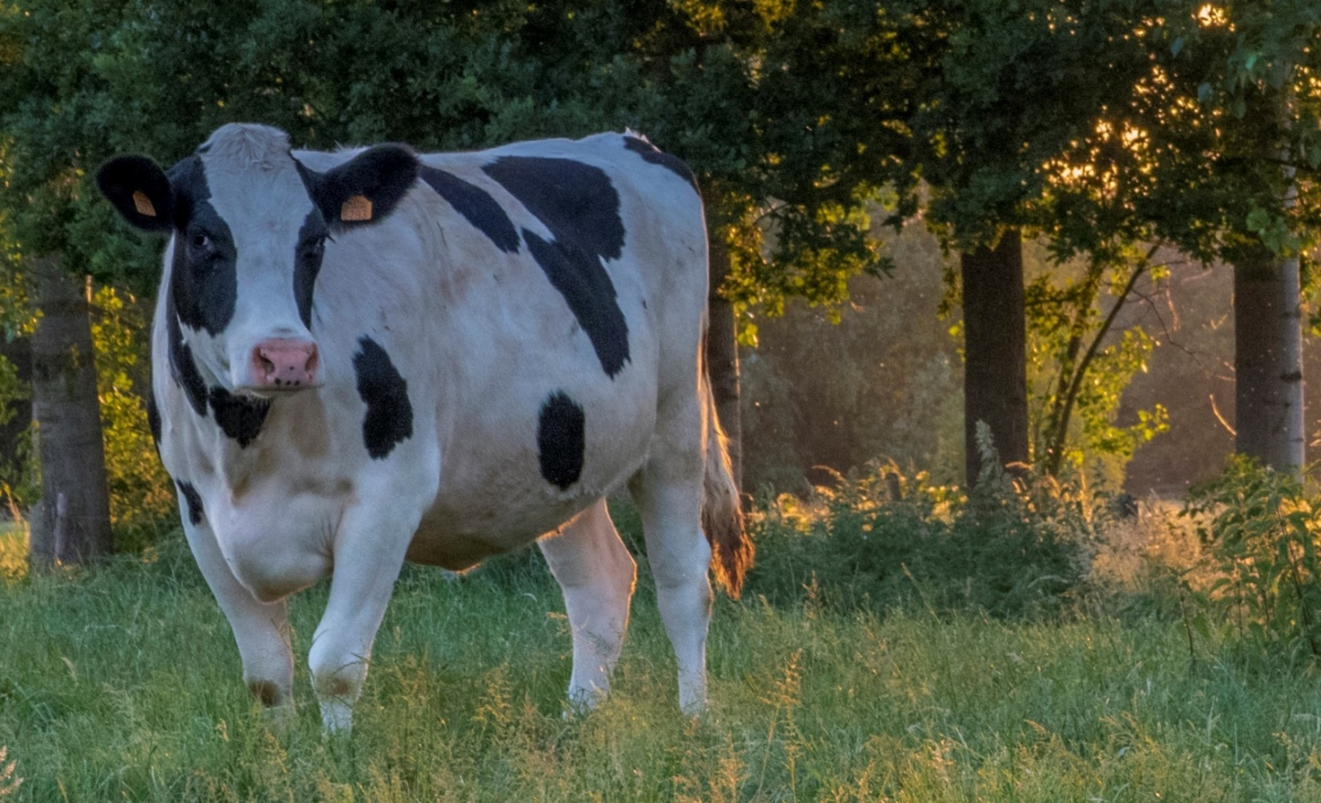
Beware, this is a proposal currently being discussed in by Member States in the Council and the Parliament
We need an AKIS budget within the CAP ringfenced budget (position paper ModernAKIS)

Slide 38
Questions?
Thank you for your attention
Inge.Van.Oost@scarlet.be
mobile +32 478 65 20 21

Slide 39

Building and linking AKISs across the EU
Speed up creativity and practice application
Better connectivity and quicker circulation of information

Slide 40

More info available in next slides…..

Slide 41
CAP post-2027 – Article 19 CAP COM(2025) 560 final:
  SHALL: a) Support to prepare and implement the projects of the EIP-AGRI operational groups as well as actions to ensure broader uptake of projects’ results (EIP OGs)
    (b) Support for actions to promote innovation, training and advice, skills development, advisory services and other forms of knowledge sharing and dissemination of information. (KNOW)
  Aims of the EIP-AGRI: results of EIP OG to be disseminated and multiplied through AKIS
  Projects implemented by the EIP-AGRI OGs based on the ‘interactive innovation model’:
    develop innovative solutions focusing on the specific needs of farmers, forester holders and rural actors;
    bring together partners with complementary knowledge such as academia, researchers and the farming community, and where relevant, actors of the food chain and ensure their active involvement in projects;
    the projects are co-created and co-decided among the actors involved in the projects and implemented in a consultative manner, including ensuring the potential for scale up
    Member States shall ensure that the key results … are disseminated through practice-oriented channels, including the national and Union CAP networks. ….with focus on the practical innovative solutions developed.

Slide 42
CAP post-2027 – Article 19 CAP clarifications
  Covers costs for each of the 3 steps of an EIP innovation project: preparation, implementation, uptake of results
  Up to 100% support for OG projects, must comply with CAP objectives Art.3 NRP, State aid rules may set limits and conditions (to be followed up)
  Cross-border OGs? Yes, no specific rules or procedures
  Yes, EIP innovation may still be based on new practices but also on traditional practices in a new geographical or environmental context
  No State aid exemption up to 500.000 Euro per project (yet)
  No explicit advanced payments (yet)
  No ringfenced CAP budget, so Art. 20(1) NRP = minimum 60% national contribution rate (40-15) instead of up to 80% EAFRD now (= 20% national contribution)
  75% (85% young) support for investment only for farmer as partner in the group (=> ringfenced CAP), no % for other actors (= not ringfenced budget under NRP)
  Obligatory Simplified Cost Options (lump sums, unit costs, flat rate) below 100.000 Euro (Art.78 NRP)

Slide 43
CAP post-2027 – Article 20 “Agricultural knowledge and innovation systems and farm advisory service“
  Each Member State shall ensure that farmers and forest holders have access to innovation and that new knowledge reaches them in a timely and effective manner, enabling them to deploy innovative and sustainable solutions effectively and profit from up-to-date knowledge in the agricultural sector.
  To meet the requirement laid down in paragraph 1, each Member State shall establish in the NRP Plan how innovations and up-to-date knowledge reach farmers, in particular through the Agricultural Knowledge and Innovation System (the AKIS). ….
  As part of the AKIS, Member States shall describe in the NRP Plans, and implement, a system for provision of farm advisory services to be established to support access to knowledge and wider deployment and use of innovations (organization of advice integrated in the AKIS – no “silo” FAS).

Slide 44
CAP post-2027 – Article 20: Advice elements
  The farm advisory services shall cover all the following elements:
    (a) Tailored advice to farmers and forest holders on sustainable and resilient management of land, farms and forests …, as well as on the requirements for support set out in the NRP Plans, including farm stewardship, setting-up and transfers of holdings and start-ups; business management, access to social support, raising awareness about mental health issues and availability of the relevant services; and the use of innovations, data-driven solutions and digital tools;
    (b) targeted advice for young farmers, in particular as regards business management, access to finance, access to public support, access to knowledge and innovation.
  Member States shall ensure that farmers and forester holders have direct access to advisors, such as by providing public databases of advisors. Member States shall ensure that the advice provided to farmers and forest holders is impartial, + that advisors are suitably qualified & free from conflict of interest (no certification).

Slide 45
CAP post-2027 – Article 20 “Agricultural knowledge and innovation systems and farm advisory service“
  Each Member State shall ensure that farmers and forest holders have access to innovation and that new knowledge reaches them in a timely and effective manner, enabling them to deploy innovative and sustainable solutions effectively and profit from up-to-date knowledge in the agricultural sector.
  To meet the requirement laid down in paragraph 1, each Member State shall establish in the NRP Plan how innovations and up-to-date knowledge reach farmers, in particular through the Agricultural Knowledge and Innovation System (the AKIS). ….
  As part of the AKIS, Member States shall describe in the NRP Plans, and implement, a system for provision of farm advisory services to be established to support access to knowledge and wider deployment and use of innovations (organization of advice integrated in the AKIS).

Slide 46
CAP post-2027 – Article 20 - AKIS strategies (= organization)
  2. (ctd) The AKIS (strategy) shall include (see Art 22(2)(i)(ii) NRP on content of plans):
  arrangements to ensure effective knowledge flows and synergies between advisors, researchers, practitioners, national CAP networks and other relevant stakeholders;
  actions to improve access for farmers and forest holders to impartial and qualified advice;
  support for innovation as a part of the farm advisory services, particularly support for the EIP-AGRI operational groups ( => innovation support services)
  a plan to improve dissemination and demonstration of research outcomes and innovative and sustainable solutions to farmers, forester holders and other end-users at a large scale;
  interventions set out in the NRP Plan supporting AKIS operation, in particular those referred to in Article 19, and their complementarity and coherence with relevant national initiatives and other relevant measures set out in the NRP Plan;
  a system for provision of farm advisory services, established in accordance with paragraph 3. (=> organization of advice)

Slide 47
CAP post-2027 – Synergies between EIP-AGRI and FP10
  Recital 15 to CAP proposal:
  In line with the need to boost innovation and more sustainable practices, the European Innovation Partnership for agricultural productivity and sustainability (the ‘EIP-AGRI’) should remain a key policy tool, to support interactive innovation, enhancing the exchange of knowledge between actors with a view to spreading solutions ready for practice (see EIP Commission Communication 2012).
  Synergies between the CAP and the Union Research Framework Programme (FP10), established by Regulation (EU) …/… of the European Parliament and of the Council, should encourage agriculture to make the best use of research and innovation results, in particular those stemming from projects funded by FP10 and the EIP-AGRI, leading to innovations in the farming and bioeconomy sector and rural areas.
  Multi-actor approach requirements in Horizon Europe projects (eligibility condition): “it is strongly recommended to involve interactive innovation groups such as the EIP-AGRI operational groups funded under the CAP”.

