Slide 1
Integrating advisors into the AKIS
Elena-Teodora Miron
LFI
June 25, 2026

Slide 2
Regulatory framework of CAP 2023 - 2027
1
Farm advice organized within the AKIS structures in CAP Strategic Plans (Art 78 & 15) – fundamental changes
All advisors shall:​
be impartial and integrated within the AKIS in an inclusive way​
be able to cover economic, environmental and social dimensions​
deliver up-to-date technological and scientific information developed by research
provide innovation support, in particular for preparing and implementing operational group projects of the EIP-AGRI​
​
Obligatory regular training for advisors​
​
Importance of showing the public list of impartial advisors and their specialisations/expertise on the Ministry's website (also to enable synergies with Horizon projects, facilitating to find the right competent advisors for their consortium)​
!
!
AKIS….Agricultural Knowledge and Innovation Systems

Slide 3
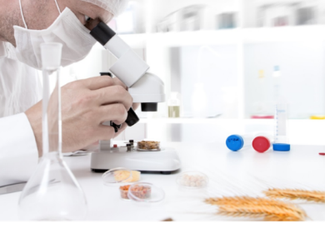
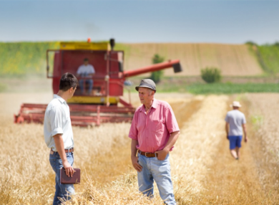
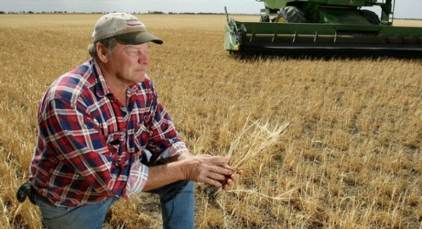
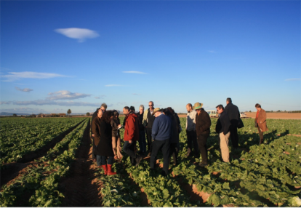


Exkursus: What is AKIS? Why AKIS?
1
AKIS = Systemic approach, focused on creation innovation ecosystems and on how knowledge is generated and disseminated
AKIS
Researchers
Advisers
A good AKIS will bring actors together on a structured and regular basis, creating continuous interaction to speed up knowledge exchange, knowledge flows, innovation and most of all: implementation in practice.
Education
Farmer
at the centre of the integrated Agricultural Knowledge and Innovation System (AKIS) to support modernisation, innovation and knowledge flows
Businesses
Organisations
Media

Slide 4
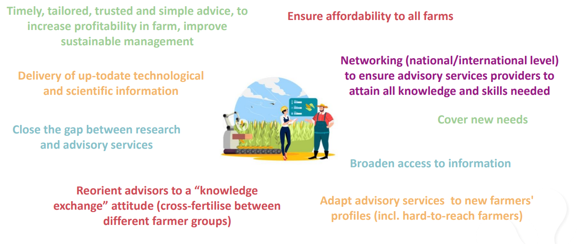
Why integrate advisors into the AKIS? Benefits?
1
Source: Cristiano, Proietti (2024), Understanding advisory services and their role in the AKIS

Slide 5
How do advisors see the value of their integration into the AKIS?
A Europe-wide survey
2
Source: modernAKIS/IALB/EUFRAS Advisors Survey, 2025 (Total of 974 respondents)

Slide 6
How do advisors see the value of their integration into the AKIS?
A Europe-wide survey
2
Source: modernAKIS/IALB/EUFRAS Advisors Survey, 2025 (Total of 974 respondents)

Slide 7
Sources of knowledge for advisors
2
Source: modernAKIS/IALB/EUFRAS Advisors Survey, 2025 (Total of 974 respondents)

Slide 8


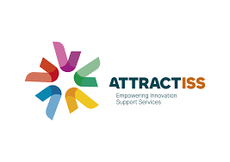
International opportunities for advisors to increase their methodological skills and competences
3
CECRA (Certificate for European Consultants in Rural Areas) certificate, provides advisors with the following key competences and skills:
Process facilitation and group dynamics skills to effectively support collaboration and decision-making in rural development and innovation contexts.
Communication and advisory techniques to engage clients constructively, build trust, and adapt to diverse advisory situations.
Self-reflection and professional development abilities to continuously improve personal advisory practice and adapt to changing environments.
Certification.
Thematic focus: Interactive innovation
Competences and skills delivered:
Facilitation skills for group processes, collaboration, and inclusive participation in innovation networks.
Communication and interpersonal skills to build trust and engage effectively with diverse stakeholders.
Enabling skills for interactive innovation processes
Reflection and adaptive learning to continuously evaluate and improve their advisory approaches in co-creation settings

Slide 9

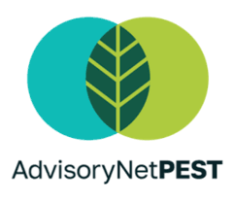




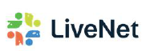


International opportunities for advisors to increase their technical skills and competences
3
Climate mitigation advice on farms
Short food supply chain and direct marketing advice
Novel approaches in organic advice
Novel approaches in pesticide reduction advice
Innovative advice in animal health and welfare
Innovative advice on soil health and management
Innovative advice on fertiliser use
Innovative advice in forest management
Peer-learning (advisors to advisor) + scientific validation on new approaches for practice
Demonstration on farms – practical applicability and co-creation with farmers
Online and on-site trainings for advisors
Network building and exchange

Slide 10
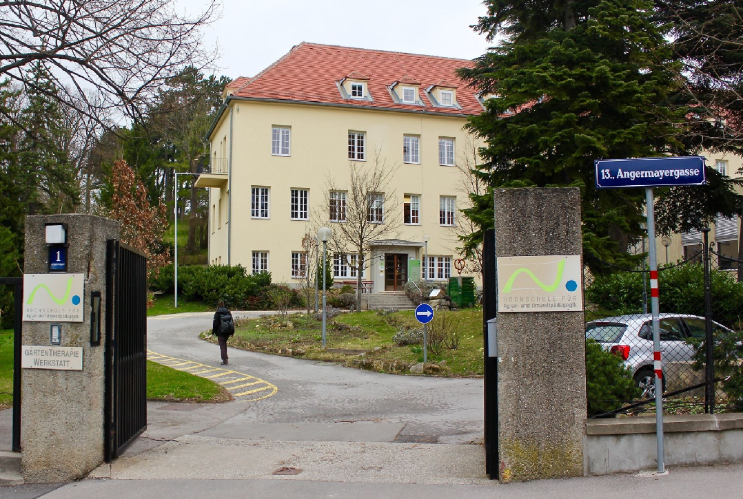

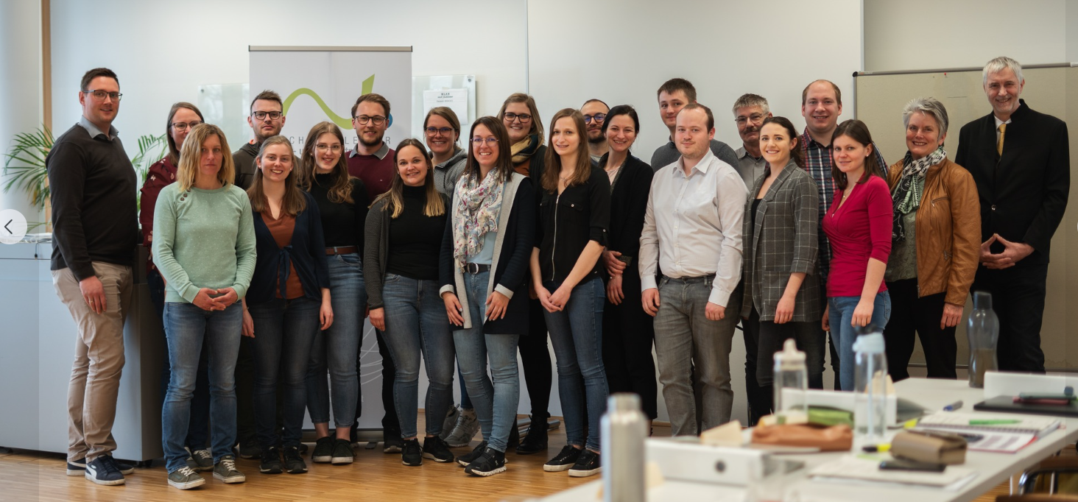
National opportunities for advisors to increase their skills and competences – the Austrian example
3
College for Agricultural and Environmental Pedagogy
Pedagogical centre for initial and continuing education of teachers and advisors in agricultural, forestry and environmental pedagogical professions
Provides a continuous education programme (demand-driven) for teachers and advisors
  Plan is developed on annual basis in a participatory process
  Approx. 350 trainings per year (different formats), in addition 10 university course are offered
  In total about 9.000 participants per year

Slide 11
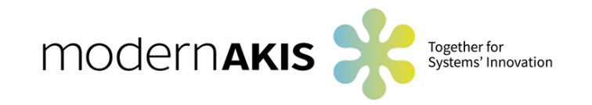
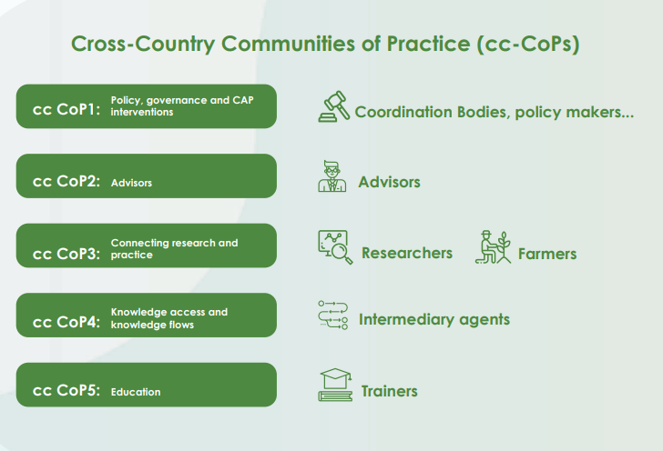
Opportunities for policy support for integrating advisors into the AKIS
3
Mixed groups of policy makers, advisory coordinators, farmers and farmers representatives (cc CoP2) co-creating policy recommendations for better integration of advisors into AKIS (including training)
2 representatives per Member State; all 27 Member States represented
Goal: enable farm advice best suited to practice needs in line with current scientific discoveries

Slide 12

Opportunities for policy support for integrating advisors into the AKIS
3
Face-to-Face meeting
Online meeting
APR
MAY
JUN
JUL
AUG
SEP
OCT
NOV
DEC
AKIS strategies in the new CAP
AKIS strategies in the new CAP (II)
EIP cooperation
ccCoP1
RO
Training by advisory orgs.
Generational renewal II
Training for private & public advisors
Training abroad
Credentials & certs.
ccCoP2
EE
PL
GR
Demand articulation II
ccCoP3
AKIS Portals
ccCoP4
RO
Demo farms
Demo farms II
ccCoP5

Slide 13
Opportunities for advisors from modernAKIS
4

Slide 14
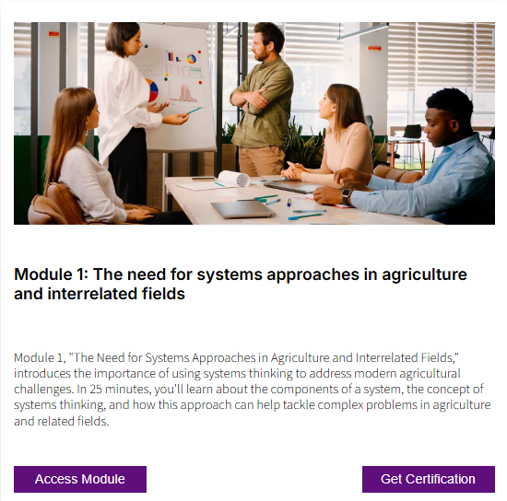
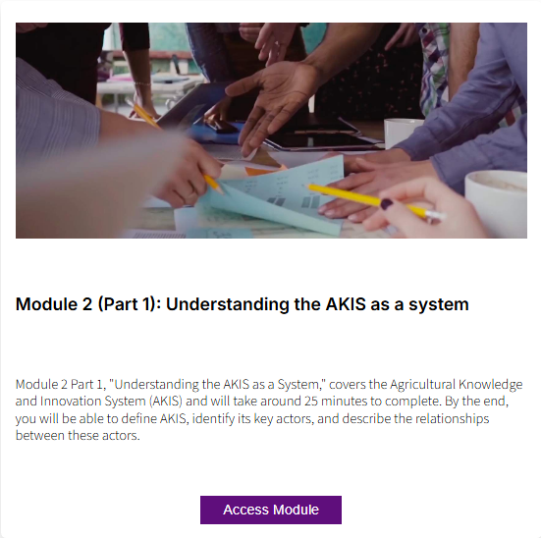
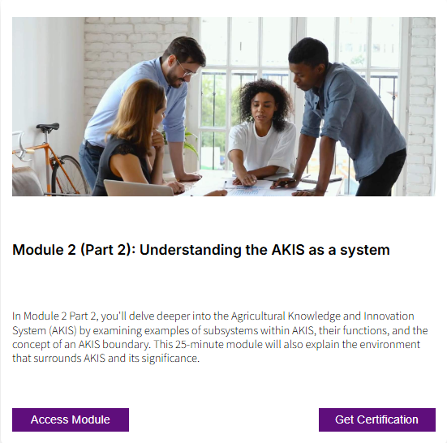
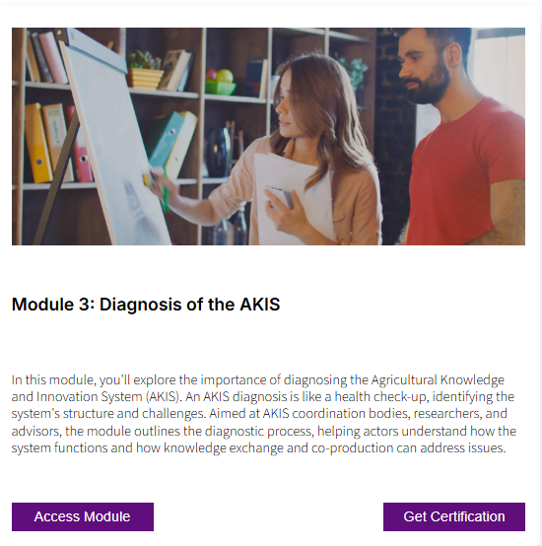
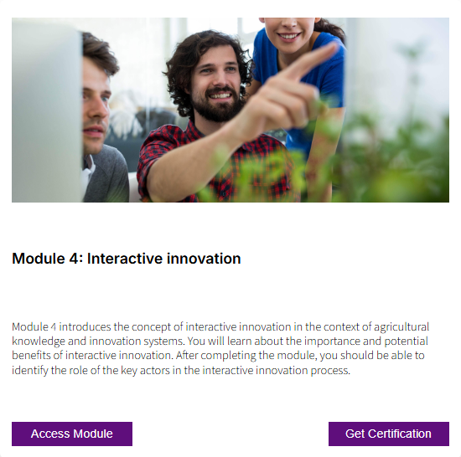
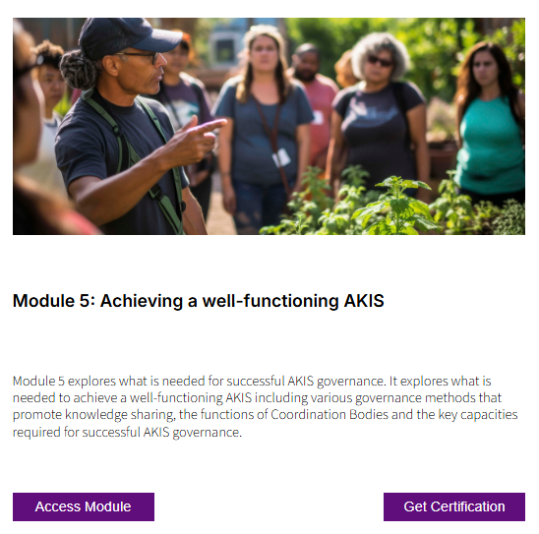
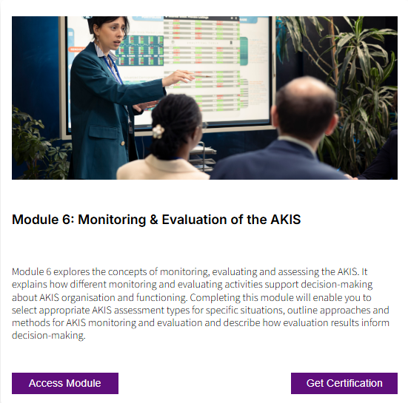
AKIS e-Learning Modules
4
www.akisconnect.eu/en/training-materials

Slide 15
AKIS e-Learning Modules
4
RESULT
Available for learners to explore the AKIS concept and gain insights into system thinking, the AKIS, diagnosing and solving
system-level issues effectively.
AUDIENCE
Key actors of change: Including national coordination body (CBs) members and modernAKIS CoP members
Trainers: Encompassing trainers with proficient training skills in interactive trainings, hailing from different European countries
BENEFITS
No language barriers (EU languages)
Uses simple and clear terminology to ensure common understanding
Interactive format ensures full mobile compatibility; each module is optimized for efficient 30-minute completion.
Visual materials reflect the diverse social, cultural, and geographic contexts of agriculture, forestry, and rural sectors across Europe.
Focuses on both instructional content and user experience (UX) to create an engaging, relevant, and informative learning journey for end users.

Slide 16
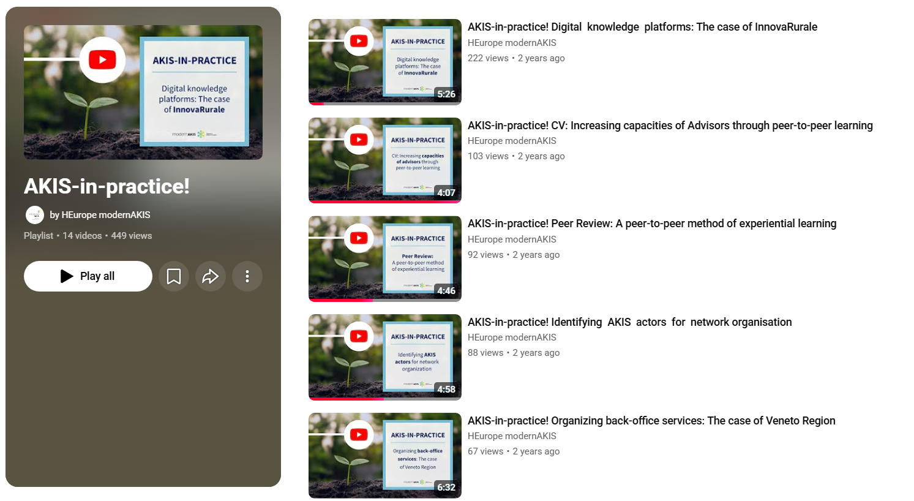
AKIS PRACTICES VIDEOS
YouTube modernAKIS
4

Slide 17
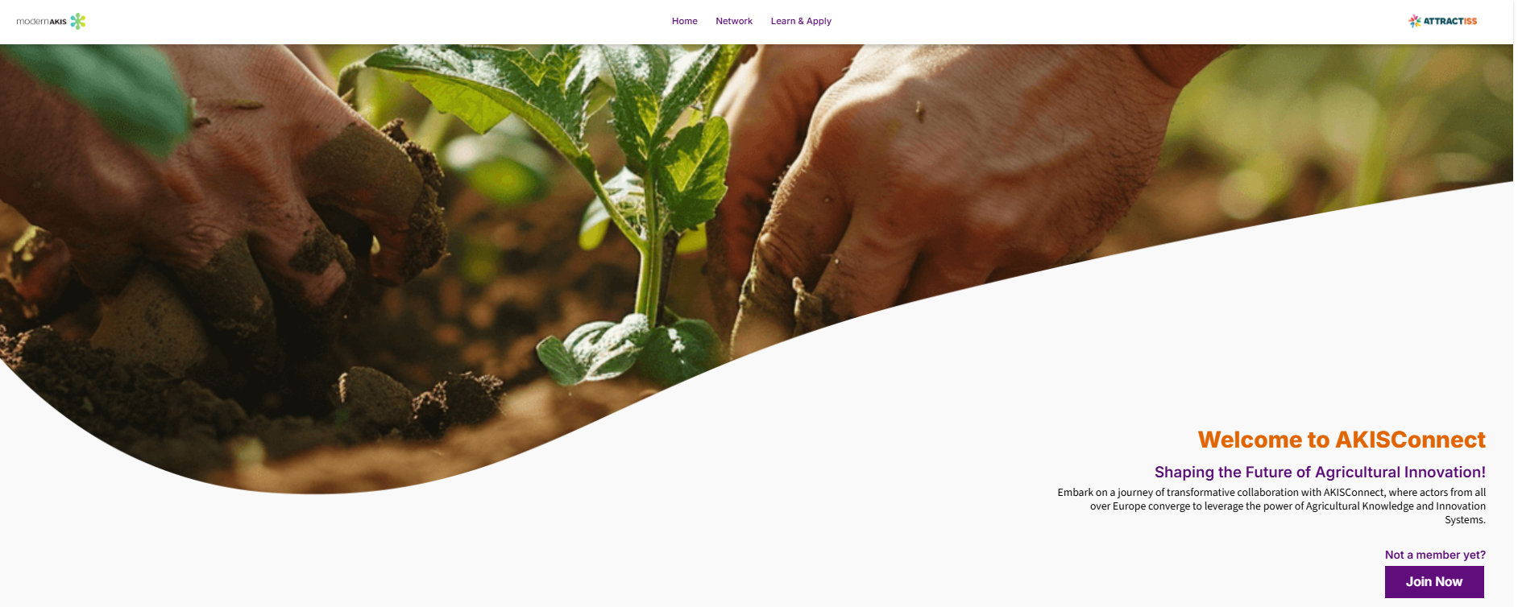
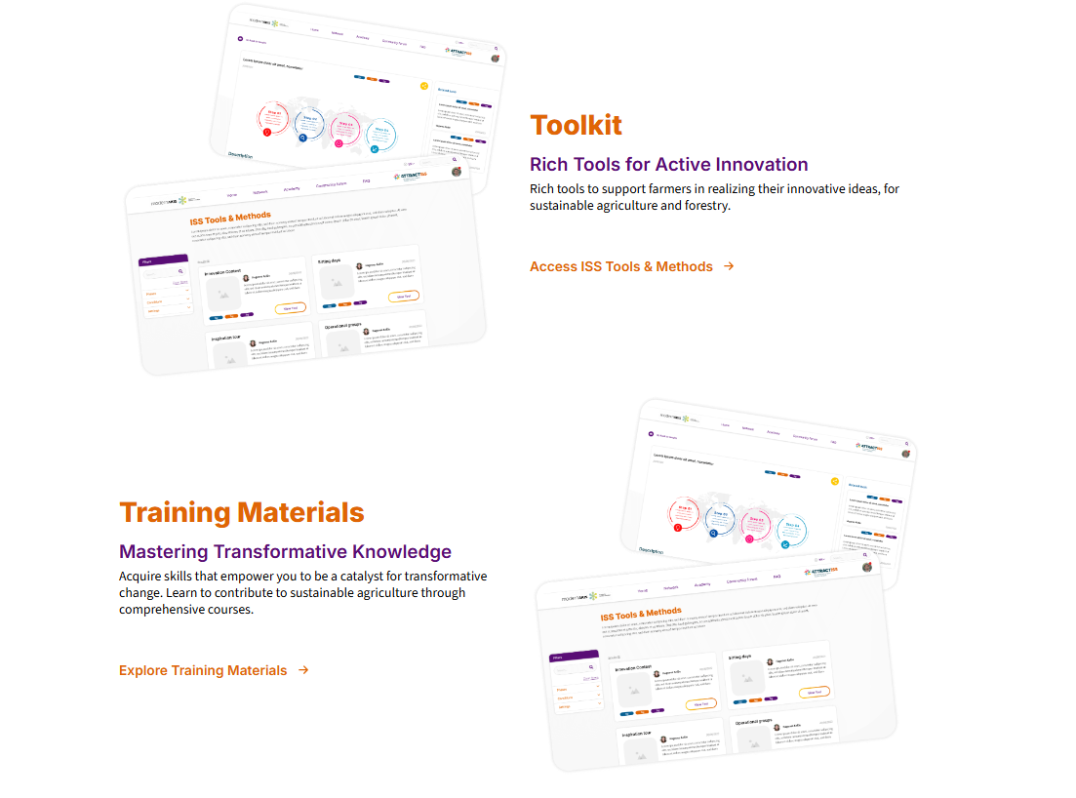
AKISConnect – the AKIS networking platform
4
RESULT
AKISConnect is an interactive platform that connects AKIS actors from across Europe to share knowledge, build capacity, and collaborate on innovative agricultural practices.
BENEFITS
This platform can be used to:
Foster cross-border collaboration
Networking
Share best practices
Strengthen regional agricultural networks through active participation and exchange.
Source: akisconnect.eu

Slide 18
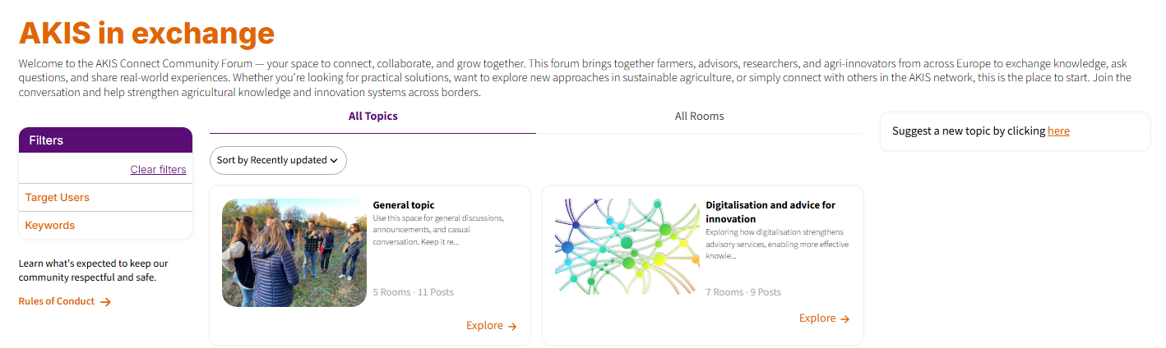
AKISConnect Community Forum – AKIS in exchange
4
A space to connect, collaborate, and grow together. This forum brings together farmers, advisors, researchers, and agri-innovators from across Europe to exchange knowledge, ask questions, and share real-world experiences. Whether you're looking for practical solutions, want to explore new approaches in sustainable agriculture, or simply connect with others in the AKIS network, this is the place to start.
Join the conversation and help strengthen agricultural knowledge and innovation systems across borders.
!
www.akisconnect.eu

Slide 19
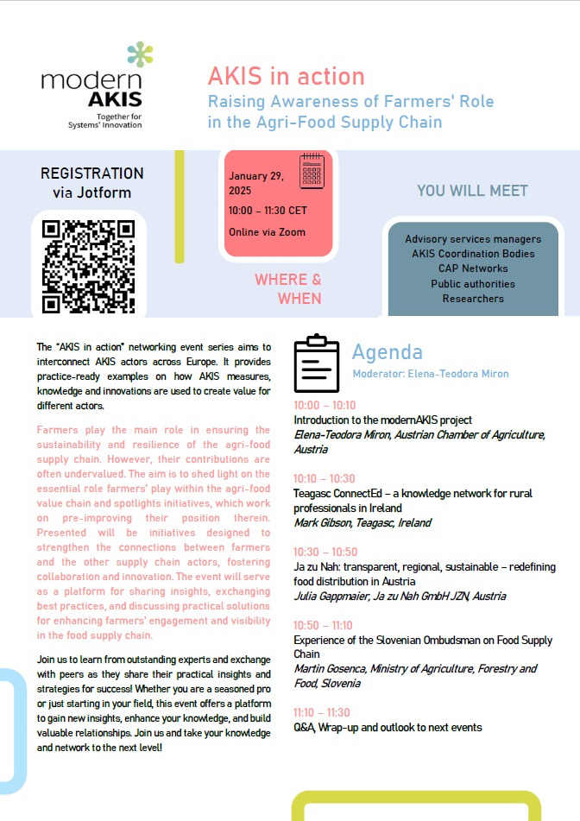
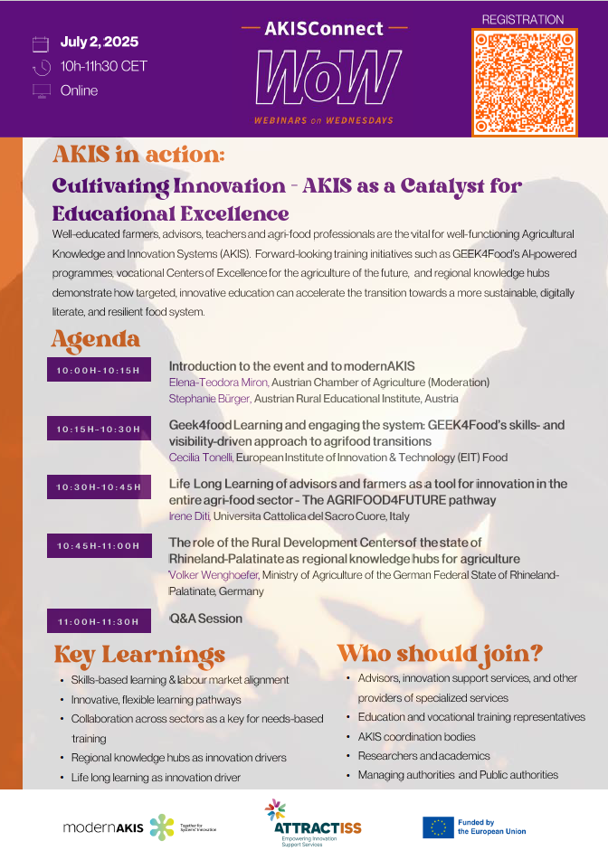
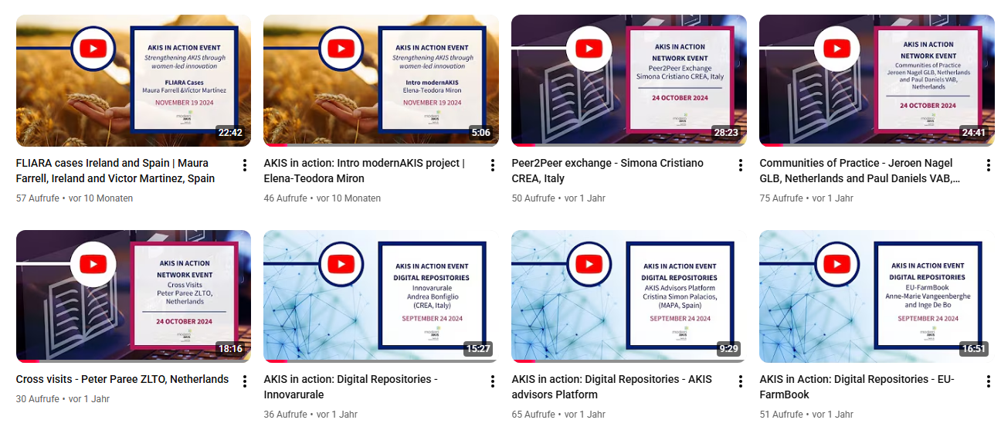
AKIS in action Webinars
4
40
countries
42
topics
13
events
1.850
participants
Recordings & presentations are available on modernAKIS YouTube Channel & AKISConnect
Now part of the WoW series (Webinars on Wednesday), hosted by modernAKIS and ATTRACTISS
Notes:
St

Slide 20
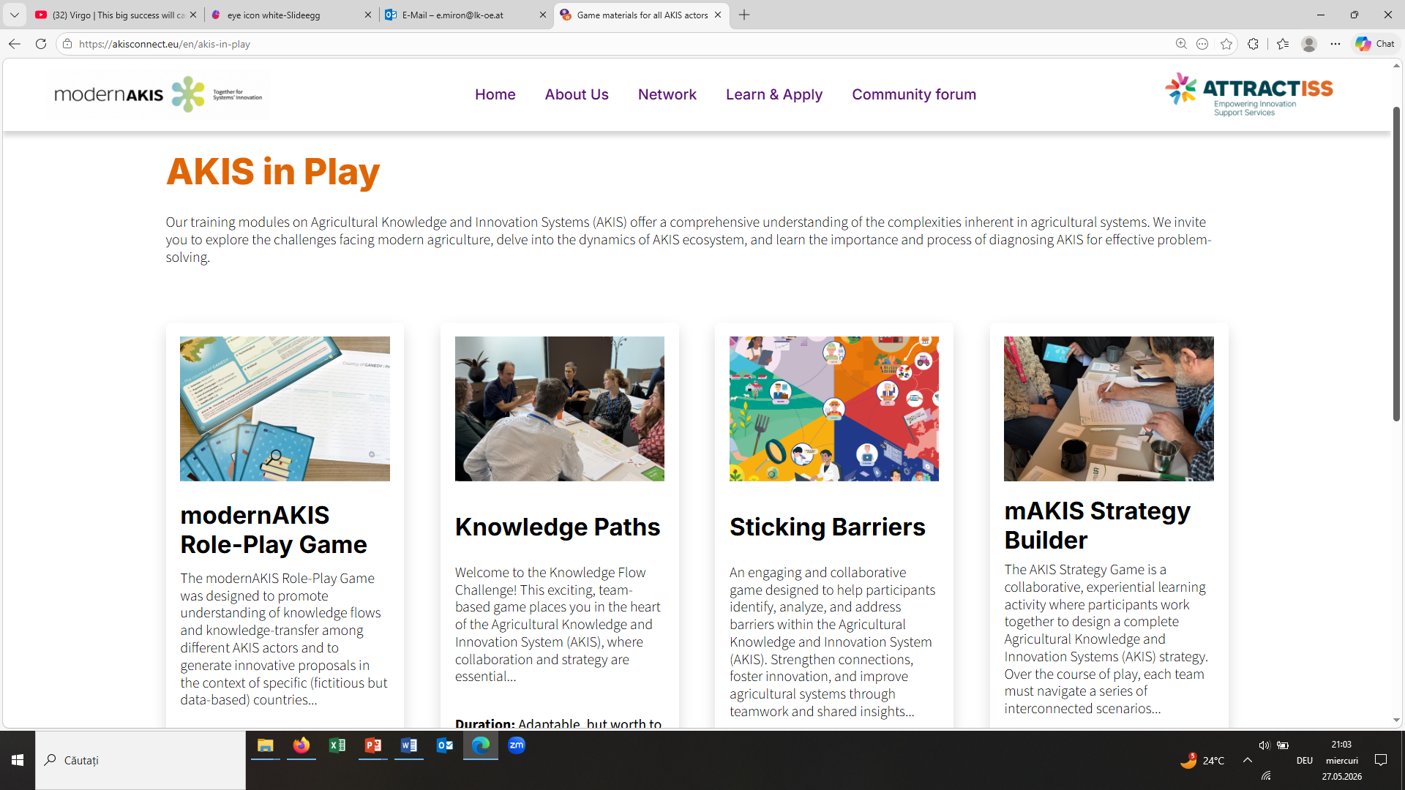
AKIS Serious Games
4
www.akisconnect.eu/akis-in-play

Slide 21
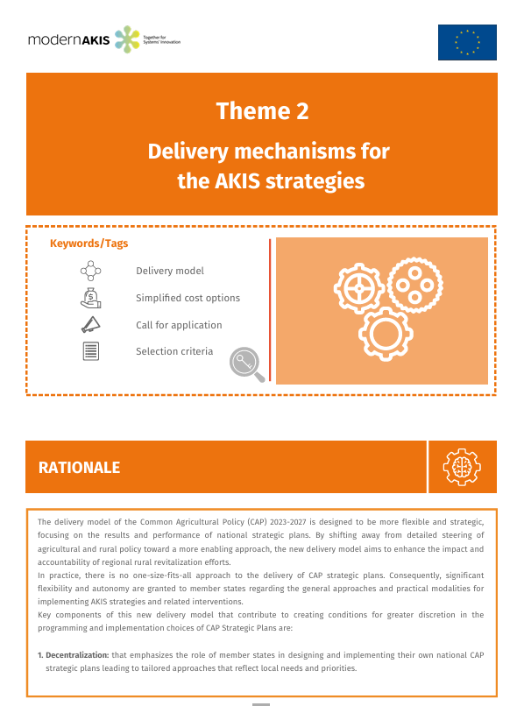
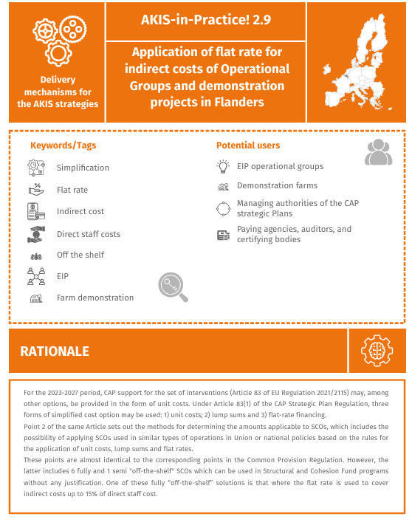
AKIS PRACTICES
4
www.akisconnect.eu/akis-in-practice
RESULT
This AKIS-in-Practice showcases real AKIS practices from EU Member States, highlighting successful interventions and best practices in agriculture. The thematic content of the more than 140 practices, covers sustainable farming, rural development, and innovation strategies within the CAP framework.
BENEFITS
AKIS-in-Practice resources can be integrated into training sessions, policy discussions, or educational materials to provide examples of proven strategies and inspire the adoption of effective practices.
Source: AKIS practices / ModernAKIS_D1.4-1.pdf

Slide 22
E: e.miron@lk-oe.at
www.modernakis.com

