Slide 1
COMMON AGRICULTURAL POLICY
AKIS seen from the EU level:
State of the art 2023-2027, Ecosystem, and Future CAP post 2027
Inge Van Oost
Active Senior Expert AKIS coordination
14 March 2026
Thessaloniki
^{CAP 2023-2027}

Slide 2

The AKIS at the heart of the agricultural innovation ecosystem
What is an Agricultural Knowledge and Innovation System (AKIS)?
  What: AKIS is the organisation and interaction of persons, organisations and institutions who use and produce knowledge and innovation for agriculture and interrelated fields. (definition in Art.3)
  Who: The main players of the AKIS are: farmers/foresters, advisors, researchers, (farmer) organisations, NGOs, networks, retailers, media, services, various ministries…: they all produce and need knowledge!
  Why: The aim is to create a regional/national innovation ecosystem by enhancing knowledge flows between the AKIS players as well as strengthening links between research and practice.
  Brief "What is AKIS": https://agriculture.ec.europa.eu/system/files/2019-04/building-stronger-akis_en_0.pdf

Slide 3
AKIS at the heart of the agricultural innovation ecosystem => Cross-cutting CAP support to Systematically share Knowledge and Innovation in Agriculture and rural areas including in whatever farming and rural activities automatically relate to (= environment, climate, biodiversity, landscape, consumers and citizens, food and non-food systems including transformation and distribution chains, etc)
Where does the AKIS policy come from?
In their 2008 declaration, the researchers of the Standing Committee of Agricultural Research (SCAR) stated that the classical linear research model does not function anymore to have real impact in the field. The current CAP AKIS policy and potential interventions can make use of the current formats and experiences from MS. Experts from about 24 MS from the SCAR Strategic Working Group collected this in the AKIS4 report, and based it on their discussions and own practical experiences. In the report much about AKIS in all its aspects is explained and a long series of possible types of interventions and concrete examples given. The report is available on the Europa "Future CAP" website and is called "Report: preparing for future AKIS in Europe". You can download it here: https://ec.europa.eu/info/food-farming-fisheries/key-policies/common-agricultural-policy/future-cap#innovation or ask to you a paper copy

Slide 4
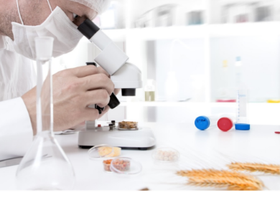
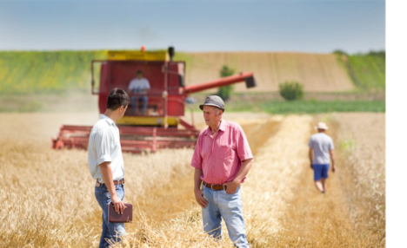
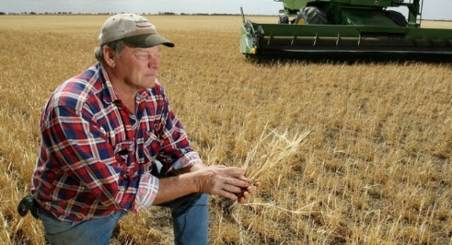
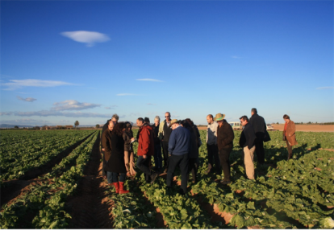


WHY focus on AKIS? A reinforced AKIS integrates all AKIS actors and ensures knowledge flows inside Member States & across borders
AKIS
Researchers
Advisers
Education
Farmer
at the centre of the integrated Agricultural Knowledge and Innovation System (AKIS) to support modernisation, innovation and knowledge flows
Businesses
Organisations
Media
A good AKIS strategy in the CAP will bring actors together on a structured and regular basis, creating continuous interaction to speed up knowledge exchange, knowledge flows, innovation and most of all: implementation in practice

Slide 5
AKIS strategy
strengthening synergies between interventions/actions and actors
EIP OGs
Education & Training
On farm demo
Advice
Knowledge exchange

Slide 6

The EIP-AGRI & AKIS have the same principles
  The EIP-AGRI applies an overarching "Open innovation" concept based on the interactive innovation model (applied in CAP Operational Groups and Horizon Multi-Actor projects), see Art 127(3):
    Collaboration between various actors to make best use of complementary types of knowledge (scientific, practical, organisational, etc) in view of co-creation and quick spreading of solutions/opportunities ready to implement in practice.
  EU wide knowledge and innovation network linking actors: communication, partnering, dissemination, knowledge flows and collecting practice needs

Slide 7
"I not only use all the brains that I have,
but all that I can borrow"
Woodrow Wilson –
President of the USA, 1913-1921

Slide 8
CAP plans 2023-2027 – main new AKIS issues
The CAP Strategic Plans regulation provides many new or improved tools for AKIS under the Cross-Cutting Objective:
  Farm advice: MS must have impartial advisors integrated within the AKIS covering all sustainability fields with up-to-date K&I, obligatory training
  Support for knowledge exchange and information events, including for advice, demo and training, thematic and cross-sectorial events
  Obligation to provide innovation support for OGs - from grassroots ideas
  CAP networks: will connect existing OGs to collaborate & interact with Horizon Europe NCPs
  EIP Operational Groups: 80% EU cofinancing instead of 43%
  100% support for non-productive investments for OGs (e.g. for K&I OGs)
  Advance payments up to 50% for OGs, important for small actors to take the lead
  State Aid derogation till 500.000 Euro for OG projects

Slide 9
CAP support for advice, training & knowledge exchange: learning profiting from & being embedded in the AKIS
Strategy
Art. 78
Funding for knowledge exchange, advice & information
Art. 77
Funding for preparing
and implementing
EIP OG projects
Art. 127
Details on EIP and OGs, interactive innovation
Art. 15
Details on advice
and innovation support
Art. 102 Modernisation in CAP Strategic Plans:
well-functioning AKIS → research + advisors
+ CAP networks + interactive innovation + digitalisation
Art. 114 Modernisation in CAP Strategic Plans:
Well-functioning Agricultural Knowledge and innovation System (AKIS) => research + advisors + CAP networks must collaborate in an interactive innovation approach
Art. 126
CAP networks fostering innovation
& knowledge exchange
Measures
to support the strategy
Notes:
You will be helpful for implementing CAP 2023-2027

Slide 10
AKIS in CAP Strategic Plans (Art.114 - R.2021/2115)
  The CAP Strategic Plans shall contain:
  Their contribution to the cross-cutting objective related to fostering and sharing of knowledge, innovation and digitalisation, notably by describing:
  The (future) organisational set-up of the AKIS: which organisational improvements are needed? (based on a SWOT)
  How advisors, researchers and CAP networks will work together within the framework of the (future) AKIS, e.g. ensure regular knowledge exchanges among them, developing national (thematic) knowledge hubs/reservoirs,...
  How advice and innovation support are provided, e.g. developing advisory back-offices/thematic knowledge hubs with specialised advisors and innovation support services

Slide 11
Farm advice organised within the AKIS structures in CAP Strategic plans (R.2021/2115 Art 78 & 15)
  Advising farmers and other beneficiaries of CAP support to be included in the CAP plans (Art 15(1) => importance of showing the public list of impartial advisors and their specialisations / expertise on the Ministry’s website (also for synergy with Horizon MA projects, enabling them to find the advisors for their consortium)
  All advisors shall be integrated within the AKIS in an inclusive way (Art 79), to be able to cover economic, environmental and social dimensions and to deliver up-to-date technological and scientific information developed by R&I (“qualifying” advisors)
  Advisors must be impartial and provide Innovation support, in particular for preparing and implementing Operational Group projects of the EIP AGRI
  Obligatory regular training for advisors
Notes:
Member States shall include farm advisory services in the CAP Strategic Plans

Slide 12

AKIS Strategic Plans in the CAP 2023-2027
Improve connections => more knowledge flows

Slide 13
AKIS strategies must interconnect, for instance
EIP OGs
Education & Training
On farm demo
Advice
Knowledge exchange

Slide 14
AKIS Coordination Body – Overall tasks
  The AKIS coordination body (CB), should be (inter)acting as the spider in the AKIS web of the country, interconnecting all key AKIS influencers
  The AKIS coordination body is the contact point for all AKIS related issues towards the European Commission:
  It should cooperate with AKIS related platforms across the geographical levels in the country, and should be following qualitatively and quantitively day-to-day AKIS interventions and actions, to know exactly how AKIS is going forward
  The AKIS CB has the main responsibility and should be in a position to ask a modification of the CAP plan if needed, while continuously supporting interaction & implementation of the AKIS Strategic plan. Make AKIS interventions as attractive and effective as possible, so that they become succesful.
  It is the formal task of the AKIS coordination body to organise the advice & impartial public and private advisors according to the new 2023-2027 advisory approach, offering advice in a transparent way (website with advisors on public Min. website) – Art 15(1), ensuring fresh inflow of expertise without too much admin burden, and ensuring frequent and effective training of advisors by competent experts.

Slide 15


Slide 16
AKIS
EIP OGs
Education & Training
On farm demo
Advice
Knowledge exchange

Slide 17
Main AKIS interventions supporting advisors within the CAP 2023-2027
  Farm advice (financing for farmers/foresters) by farm advisors
  Training and lifelong learning (financing for farmers/foresters, lead by advisors as well as training for advisors)
  Knowledge exchange and information dissemination (trainings, on-farm demonstration, discussion networks, information activities, etc.) where advisors play a key role
  EIP-AGRI operational group projects (bottom-up innovation projects including as much as possible advisors as coordinator or as partner)
Farm advisors’ integration in the AKIS: how and why?
Sustainable CAP and state financing to be secured (Art 78, 127)
  Advisors to be integrated in the AKIS to cover economic, environmental and social dimensions and to deliver up-to-date technological and scientific information developed by R&I . Support needed for advisors to do so
  Impartial advice and provision of innovation support to capture bottom-up grassroots ideas, e.g. for preparing and implementing EIP OG Operational Group projects
  Fostering farm advisors’ competences and knowledge: obligatory regular training for advisors, connecting to (thematic) knowledge reservoirs

Slide 18
Advisory activities: COM guidance April 2024
      To ensure advisory services are effective, advisors must be impartial, competent and give well-tailored individual advice.
      Therefore, all Member States are expected to develop a national public database of all impartial advisors, as a means to give a transparent view on the availability of advisors, their expertise and education.
      Such database gives farmers the freedom to choose their public or private advisor based on objective information and ensures the highest possible impact of the CAP funding invested in advice.
      This includes also their Life-Long Learnings, as advisors should follow the obligatory training for advisors, which the MS must organise according to Article 15(3). The database should of course also indicate if the advisor has followed this training.
      Specific certification procedures are not needed and may reduce the number of advisors available and visible in the database. In the end, it will be market mechanisms which will help single out the best impartial advisors, most appreciated/trusted by farmers (advisory vouchers can help).

Slide 19
Advisory activities: COM guidance April 2024
      “Keeping in mind the broad scope in which advisors can play a role, a few innovative approaches in improving effectivity of advice are listed below as examples already applied in some Member States’ CAP plans:
      - Handing over virtual vouchers directly to farmers to ensure the advice is more demand driven and meets the specific question of the farmer;
      - Providing practical info in knowledge reservoirs which focus on practical outputs. This helps advisors to get up-to-date information to share with their clients;
      - Set up public back-offices (thematic “knowledge hubs”) where specialist advisors are closely linked to respective science, collect all thematic knowledge available, thus helping any question a field advisor may receive from his clients. Such specialist advisors may join the field advisors in their work in the field where useful;
      - Promote the use of the national advisory database to help farmers to find the most competent advisors for a specific subject and spend CAP budget in an impactful way;
      - Create national advisory networks, where advisors can share experience, feel supported and can learn from each other;

Slide 20
Advisory activities: COM guidance April 2024
      - Providing a mobility budget for advisors to go on cross-visits abroad and share the novel information when coming home;
      - Face-to-face thematic events, where all AKIS actors meet and share information. Demonstration events are perfect, as well as winter meetings;
      - On-farm demonstrations/trainings led by advisors, so that they incentivise their clients to join and ensure that the demonstration/training is sufficiently applicable and attractive for farmers;
      - E-learning, podcasts, etc for advisors’ training. Such tools could also help advisors in their work with clients to showcase certain topics, examples or share information/training elements.
      All these innovative advisory formats can be supported under Article 78, and some under Articles 77 and 127 (Operational Groups), or technical assistance. The Commission Services are ready to help Member States to devise dedicated interventions in this regard.”

Slide 21
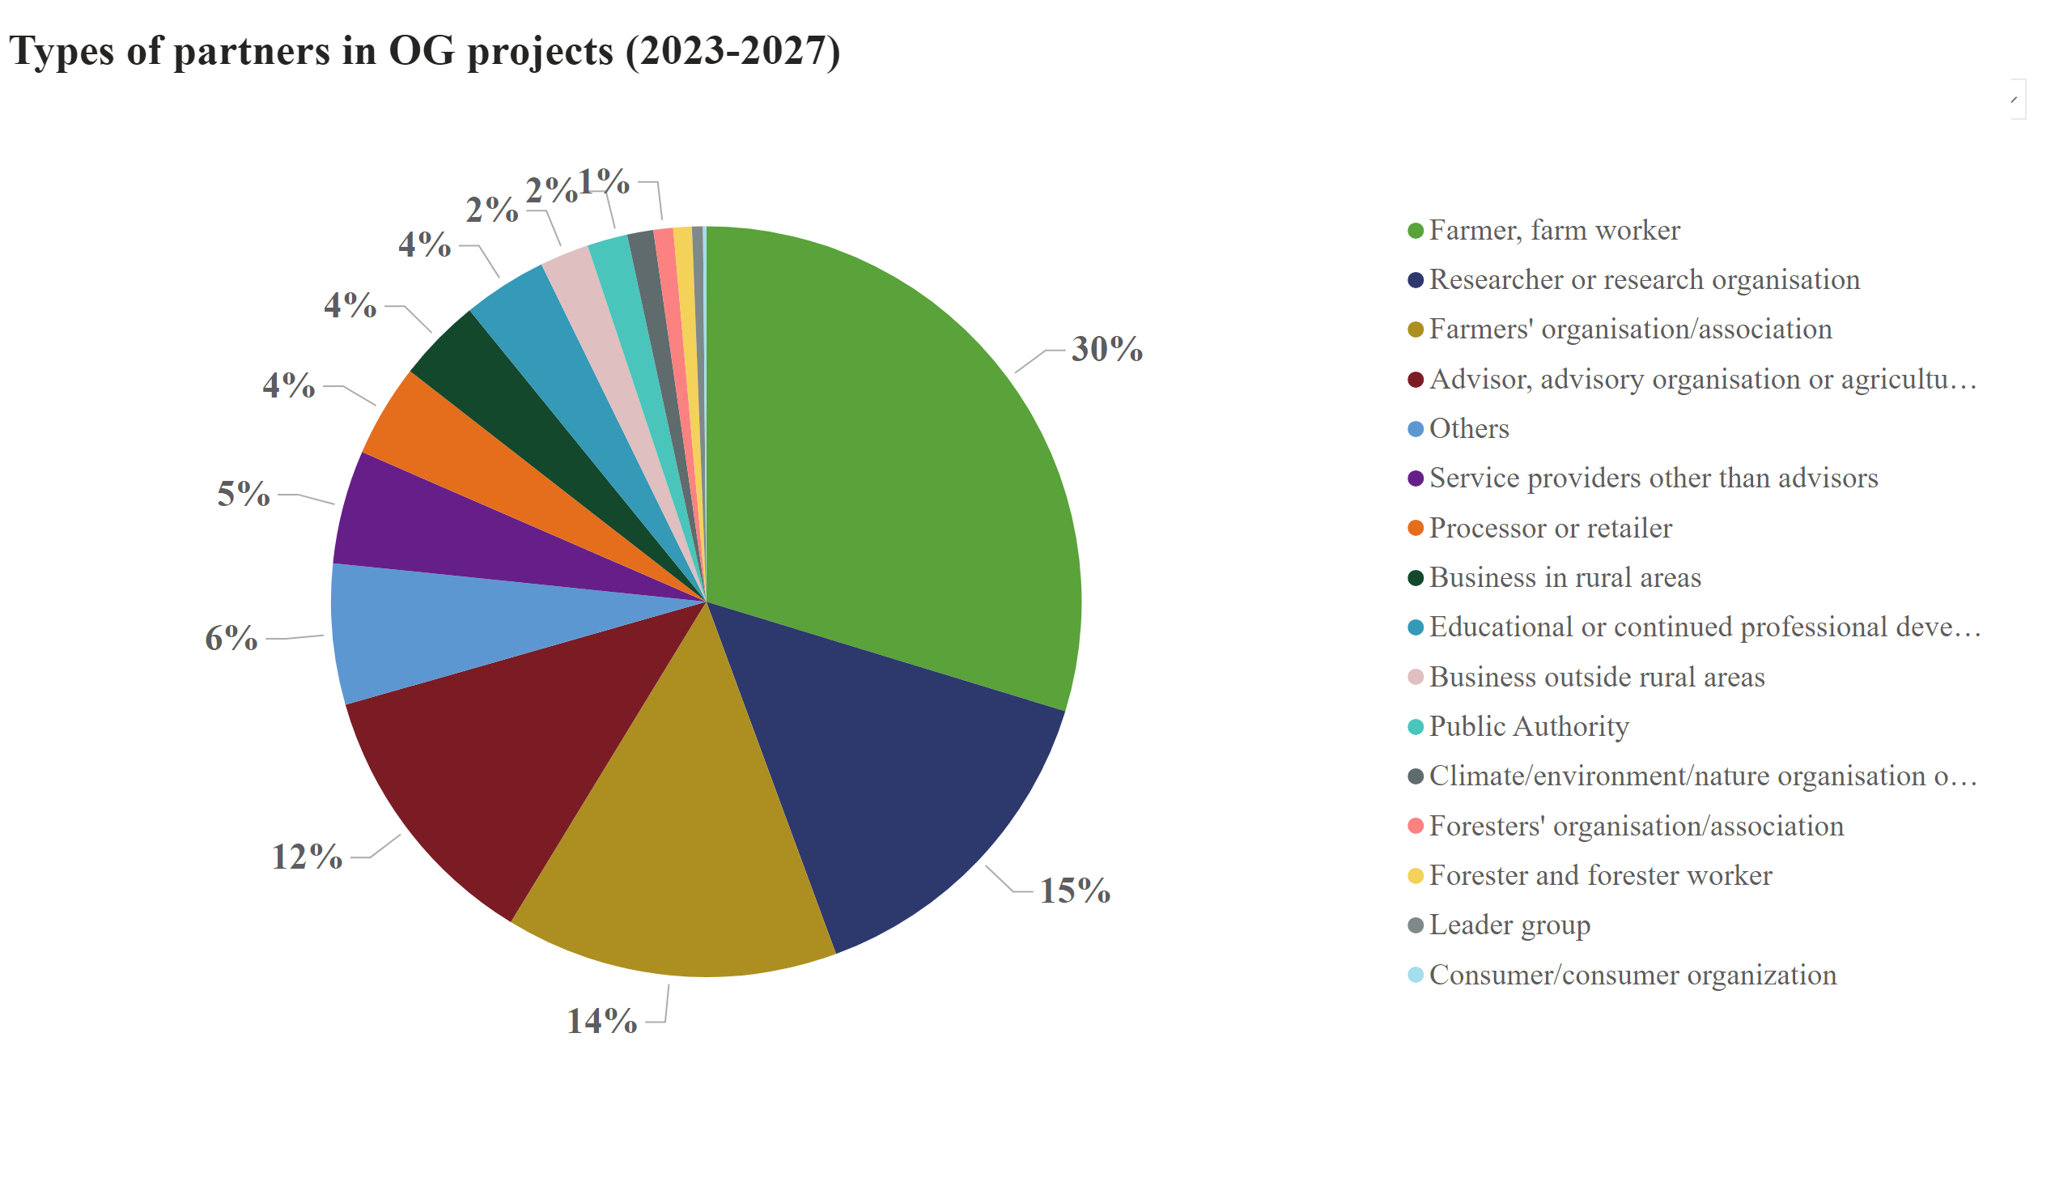
Partners
We are happy to observe an increase in advisors' participation in EIP-OG projects from 10%-12% in general
About 19 % advisors now already take the role as Lead partner (coordinator) !

Slide 22
How do advisors see the value of their integration into AKIS?
An EU wide survey by the ModernAKIS project
Advisors feel the following elements to be (very) important :
  Training opportunities
  Cooperation in AKIS
  Access to research results within AKIS
  Networking to support involvement in AKIS: at conference & workshops, in projects, at regional meetings, networking excersions, networking cross-country visits, personal exchanges, help for their methodological skills used in farm advising
  Rather not important (yet): networking through digital platforms (maybe not the right tools are available yet?). E.g. EU Farmbook may help a lot thanks to AI search and translation
  Key sources of knowledge for advisors: exchange with colleagues, specialist meetings, face to face, online events, continuous training organisation, journals. Some newer formats in the graphs are not yet much applied and may become important in the future
  See more detail in the next slides…

Slide 23
AKIS
EIP OGs
Education & Training
On farm demo
Advice
Knowledge exchange

Slide 24





EIP-AGRI connecting policies – the bigger picture
9 CAP OBJECTIVES + CROSS-CUTTING
Common Agriculture Policy
Horizon 2020/Europe
  Multi-actor projects
  Thematic networks
  Advisory networks
National CAP Networks
  EIP innovation projects by Operational Groups
  Preparation
  Implementation
  Innovation support services
  Advice, Training
RESEARCH
Unique EU knowledge repository
of contacts and practice abstracts
Spread
the results
Involvement of OGs
strongly recommended

Slide 25


From 2023, OG projects may cover all 10 CAP objectives
THE 9 SPECIFIC + 1 CROSS-CUTTING OBJECTIVES
^{INCREASE COMPETITIVENESS}
^{REBALANCE}
^{POWER IN FOOD CHAIN}
^{ENSURE}
^{VIABLE INCOME}
^{CLIMATE CHANGE}
^{ACTION}
Cross-cutting objective KNOWLEDGE & INNOVATION
^{THE 9}
^{CAP}
^{ENVIRONMENTAL}
^{CARE}
^{OBJECTIVES}
RESPOND TO CITIZENS' CONCERNS in terms of
^{FOOD & HEALTH QUALITY}
^{PRESERVE}
^{LANDSCAPES}
^{& BIODIVERSITY}
^{SUPPORT}
^{GENERATIONAL RENEWAL}
^{VIBRANT}
^{RURAL AREAS}

Slide 26
Over 5000 OGs in Europe: a wide variety of OG project subjects
“EIP” OG projects even act as a test bed for CAP measures (such as ecoschemes, agri-env-clim interventions, investments…)
(see IE example - EIP seminar Sep 2020
https://www.youtube.com/watch?v=AaxZ1IE608k )
Around half of the projects focus on sustainability, environment and climate
Sustainable pest/disease control
Smart fertilisation / Soil quality
Animal and plant health
Supply chain innovation
Biodiversity management
Organic farming productivity
Digital-based solutions
...and more
Source: European Commission – notifications in SFC
Note: in 2014-2022 period, dissemination obligation only after the project finished, so not all running projects are included in the database

Slide 27
AKIS
EIP OGs
Education & Training
On farm demo
Advice
Knowledge exchange

Slide 28
In Summary: AKIS Coordination Body, Managing Authorities and CAP Networks:
Networking and collaboration needed
  In particular, better collaboration between advisors, researchers and the CAP network must be ensured by specific initiatives (Art 114), such as advisory back-offices and thematic knowledge hubs which seem to be excellent tools
  The AKIS coordination body situated in the Managing Authority of the Ministry of Agriculture takes the lead in definining ways to strengthen AKIS
  Evidence shows that the AKIS CB are strongly supported by national/regional CAP networks/platforms/competence centres etc: do not reinvent the wheel, make the wheels role and the car move !! Make actors/organisations collaborate
  Make up a roadmap, action plan, targets, etc. Add novelties where useful

Slide 29
Improving knowledge sharing on OG outcomes and making OGs visible: drafting of AKIS interventions is essential
  Look for long living channels (after the OG project finishes, the group and its work should still be visible for follow-up work): the CAP network website, the Ag Ministry website, the website of the farmers’ organization(s), the website and newsletters of advisors, etc.
  Make the knowledge come alive through events! Reading is sooo boring….
  Interlink AKIS interventions (= your AKIS strategy): e.g.
    Train your advisors on OG outcomes
    Training can specifically take in OG outcomes and invite OG partners to events
    Make advisors/trainers part of any OG, let them support you with the events and on-farm demonstrations: if they are convinced, so will be their clients

Slide 30
Improving knowledge sharing on OG outcomes and making OGs visible – the drafting of the call is essential
  Introduce an strong obligation for communication all along the project in the project calls, not only a “plan” and not only dissemination at the end.
  Continuous following of steps in the project (on-site if possible) incites interest and involvement of end-users are key.
  Ask in selection criteria of calls which communication channels will be used and why they are the best to reach practitioners
  Use as much as possible ‘life’ events and communication tools: on-farm demonstration, videos, photos in factsheets with short texts
  A dedicated Art 78 intervention on sharing & communicating on OG outcomes is very useful and can lead to further OG work
  Use Horizon or national/regional funding sources to build on OG outcomes

Slide 31

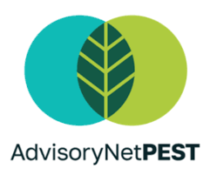




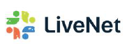


International opportunities for advisors to increase their skills and competences: Horizon Advisory Networks
Short food supply chain and direct marketing advice
Novel approaches in organic advice
Novel approaches in pesticide reduction advice
Climate mitigation advice on farms
Innovative advice in animal health and welfare
Innovative advice on soil health and management
Innovative advice on fertiliser use
Innovative advice in forest management

Slide 32
  Obligation for each MS to install Innovation support:
  Interactive innovation: Cross-fertilisation is key for tackling complex challenges and developing opportunities for innovation
Du choc des idées jaillit la lumière
Nicolas Boileau, french philosopher, 17th century
> Enlightenment comes when views collide
> From the clash of opposing minds, new ideas arise
Notes:
La confrontation d'avis, d'opinions divergents permet de révéler la vérité ou de faire éclore de nouvelles idées

Slide 33
Reaching the right partners at the right time
  Innovation support services:
  Coordination and facilitation of projects as an intermediate between partners during the project
  Brokering function for setting up operational groups: from individual idea to group's project
  Brainstorming events and animation of (thematic) groups
  Promoting innovation and innovation funding formats
  Dissemination of innovative results
  - EIP guidelines 8.1 & 8.3

Slide 34
Individual innovation support (1)
  Innovation brokering is:
  discovering innovative ideas,
  refining them,
  connecting partners,
  finding funding and take into account their requirements/selection criteria for
  preparing a project proposal with clear activities and distribution of tasks, on which all actors want to engage and agree that it will bring what they expect to be a sustainable solution (find win-win, as to eventually make the project results broadly implemented)
  - EIP guidelines 8.2

Slide 35
Individual innovation support (2)
  Who could be an innovation support service (ISS)?
  There is no CAP obligation to "recognise" innovation support services, however, informing applicants about who is providing ISS may be useful
  Make use of existing (advisory) services that have experience or are well positioned to provide innovation support
  Ideally, innovation support services should have a thorough understanding of the agricultural world as well as well-developed communication skills for interfacing and animating. Interaction with non-agricultural services is also useful.
  - EIP guidelines 8.2 & 8.3

Slide 36
To complete the innovation networking ecosystem in the new CAP: a new obligation for all MS to organize individual innovation support services (ISS)
We appreciate synergies but keeping the difference between the following 2 approaches is essential:
1) individual “innovation support services” (as in some MS already funded in this period, activities more oriented to the individual idea owner to help its emerging OG, mostly done by advisors)
2) broader “innovation networking” by the CAP networks/NRNs/regional innovation networks as already is happening in this period: are more group actions to incentivize innovation, support calls, bring together AKIS actors etc
  Do not underestimate the efforts and budget needed for individual ISS (3.000 -8.000 Euro per project, lump sums by preference)

Slide 37
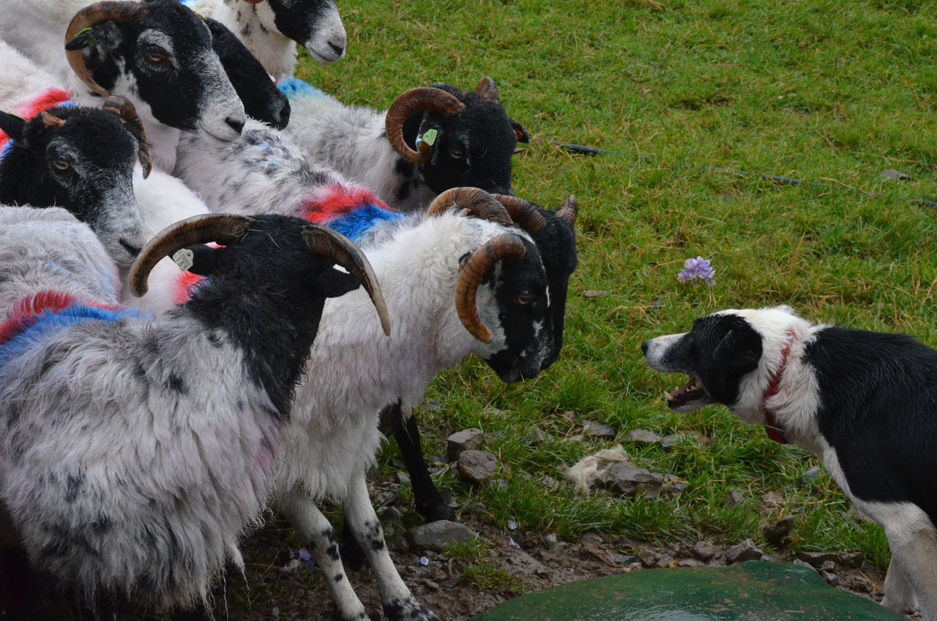
Speeding up knowledge exchange and innovation
Rounding up sheep
Driving force: AKIS Coordination Bodies

Slide 38
Agriculture will be more and more
knowledge-intensive
EIP-AGRI – What did we achieve?
26(27) Member States, 98 rural development programmes implementing EIP Operational Group ”innovative projects”
in 2014-2022 (9 years) so far 4200 OGs running or finished = ~ 1,6 bio €
Next CAP plans 6600 OGs: almost 3 x more OGs per year for only 5 years + more variety in interventions (not only “Agricultural productivity & sustainability”)
Total H2020 & HE: 385 MAA projects of 550 projects, and more on the way
A growing and thriving network:
An increasing volume of practice-oriented knowledge
ready for the end-users!

Slide 39
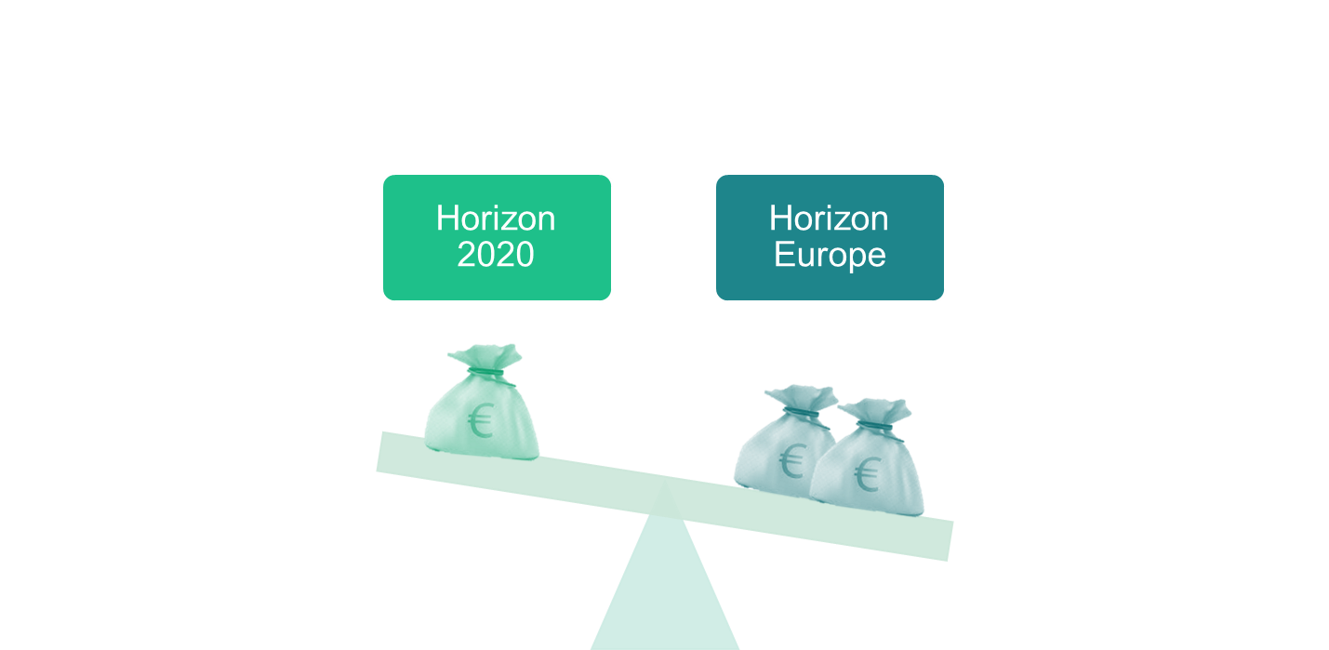
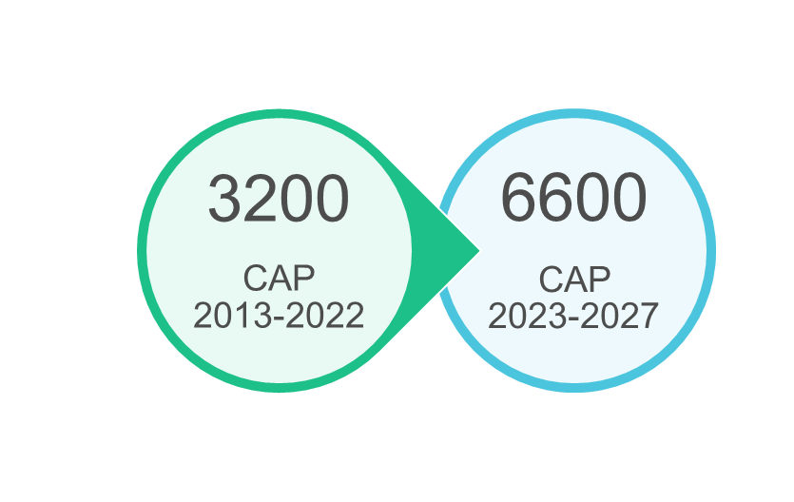

EU-wide online platform with practice-oriented results: EU Farmbook
CAP
EU-wide online knowledge reservoir: one-stop-shop to get access to practical knowledge and solutions by Horizon, CAP and beyond!
Horizon funded transnational R&I projects,
i.e., thematic networks, advisory networks and multi-actor projects
CAP funded local innovation projects i.e. EIP- AGRI operational groups
(national/regional) R&I projects beyond CAP and Horizon
Notes:
Finally, with the help of the EU-FarmBook project, which is also today with us, we are also building an EU-wide online platform that will bring together all of the tangible outputs of Horizon and CAP funded MA projects, including EIP AGRI OGS! Through this platform farmers, foresters and advisors across Europe will have one- stop-shop get access to practical new knowledge and innovative solutions. The platform intends to support the deployment of innovative solutions by the end users, helping them to adapt more sustainable practices. So, if you want to spread your outcomes across the EU among the other practitioners – this the ideal outlet for you! We strongly encourage you to contribute to the platform, as its success and power depends on the contributions from the EIP-AGRI OGs!

Slide 40
An update on the latest EU Farmbook features:
What can EU Farmbook do for OG projects?
  One-stop shop to get access to practical knowledge and solutions from CAP OG and Horizon projects and beyond
  Search robot with Artificial Intelligence (AI) to help find projects in an intelligent way (not simple keyword based)
  Already 1750 projects (1500 OGs + 250 Horizon projects) by summer 2025 and growing.
  Translation in all EU languages by summer 2025
  AI improves drafting of communication products and practice abstracts (seminar Reims, example Germany, region Niedersachsen, Fabian Storm see EU CAP network website)
  EU Farmbook is offering a free website for innovation projects/ OGs where you can share events, knowledge fiches, videos, practice abstracts, contacts etc : no need to make an own website => you can save funding/resources which you can use for your other OG activities

Slide 41
Having potential innovative knowledge is one thing, turning it into reality is another.
"The value of an idea lies in the using of it."
Thomas Alva Edison – inventor of the light bulb

Slide 42
AKIS Strategic Plans in the CAP post 2027
Small evolution => no revolution

Slide 43
AKIS in CAP post-2027: small evolution, not revolution
  The new articles on knowledge sharing and innovation are a continuation of the current regulation with continued emphasis on well-functioning Agricultural Knowledge and Innovation Systems.
  Concentration of knowledge and innovation in 2 key articles (CAP Art. 19 and 20), replacing current 5 articles spread over the CAP regulation
  Support for the preparation and implementation of EIP-AGRI operational groups and for knowledge sharing (Art.19) – replacing current Art. 77, 78 and 127
  Provisions on Agricultural Knowledge and Innovation System (AKIS) to support innovation and knowledge sharing (Art. 20). Member States need to ensure provision of advice & transparency on advisors – replacing current Art. 15 and 114
  CAP networks activities continued under NRP Art. 57 - replacing current Art. 126: objective/tasks again to foster innovation, peer-to-peer learning and knowledge sharing, build capacity and network OGs

Slide 44
CAP post-2027 – Article 19 CAP COM(2025) 560 final:
  a) Support to prepare and implement the projects of the EIP-AGRI operational groups as well as actions to ensure broader uptake of projects’ results (EIP OGs)
    (b) Support for actions to promote innovation, training and advice, skills development, advisory services and other forms of knowledge sharing and dissemination of information. (KNOW)
  Aims of the EIP-AGRI: results of EIP OG to be disseminated and multiplied through AKIS
  Projects implemented by the EIP-AGRI OGs based on the ‘interactive innovation model’:
    develop innovative solutions focusing on the specific needs of farmers, forester holders and rural actors;
    bring together partners with complementary knowledge such as academia, researchers and the farming community, and where relevant, actors of the food chain and ensure their active involvement in projects;
    the projects are co-created and co-decided among the actors involved in the projects and implemented in a consultative manner, including ensuring the potential for scale up
    Member States shall ensure that the key results … are disseminated through practice-oriented channels, including the national and Union CAP networks. ….with focus on the practical innovative solutions developed.

Slide 45
CAP post-2027 – Article 20 “Agricultural knowledge and innovation systems and farm advisory service“
  Each Member State shall ensure that farmers and forest holders have access to innovation and that new knowledge reaches them in a timely and effective manner, enabling them to deploy innovative and sustainable solutions effectively and profit from up-to-date knowledge in the agricultural sector.
  To meet the requirement laid down in paragraph 1, each Member State shall establish in the NRP Plan how innovations and up-to-date knowledge reach farmers, in particular through the Agricultural Knowledge and Innovation System (the AKIS). ….
  As part of the AKIS, Member States shall describe in the NRP Plans, and implement, a system for provision of farm advisory services to be established to support access to knowledge and wider deployment and use of innovations (organization of advice integrated in the AKIS).

Slide 46
CAP post-2027 – Article 20: Advice elements
  The farm advisory services shall cover all the following elements:
    (a) Tailored advice to farmers and forest holders on sustainable and resilient management of land, farms and forests …, as well as on the requirements for support set out in the NRP Plans, including farm stewardship, setting-up and transfers of holdings and start-ups; business management, access to social support, raising awareness about mental health issues and availability of the relevant services; and the use of innovations, data-driven solutions and digital tools;
    (b) targeted advice for young farmers, in particular as regards business management, access to finance, access to public support, access to knowledge and innovation.
  Member States shall ensure that farmers and forester holders have direct access to advisers, such as by providing public databases of advisors. Member States shall ensure that the advice provided to farmers and forest holders is impartial, and that advisors are suitably qualified and free from conflict of interest.

Slide 47
CAP post-2027 – Synergies between EIP-AGRI and FP10
  Recital 15 to CAP proposal:
  In line with the need to boost innovation and more sustainable practices, the European Innovation Partnership for agricultural productivity and sustainability (the ‘EIP-AGRI’) should remain a key policy tool, to support interactive innovation, enhancing the exchange of knowledge between actors with a view to spreading solutions ready for practice (see EIP Commission Communication 2012).
  Synergies between the CAP and the Union Research Framework Programme (FP10), established by Regulation (EU) …/… of the European Parliament and of the Council, should encourage agriculture to make the best use of research and innovation results, in particular those stemming from projects funded by FP10 and the EIP-AGRI, leading to innovations in the farming and bioeconomy sector and rural areas.
  Multi-actor approach requirements in Horizon Europe projects (eligibility condition): “it is strongly recommended to involve interactive innovation groups such as the EIP-AGRI operational groups funded under the CAP”.

Slide 48
AKIS
EIP OGs
Education & Training
On farm demo
Advice
Knowledge exchange

Slide 49

Building and linking AKISs across the EU
Speed up creativity and practice application
Better connectivity and quicker circulation of information

Slide 50
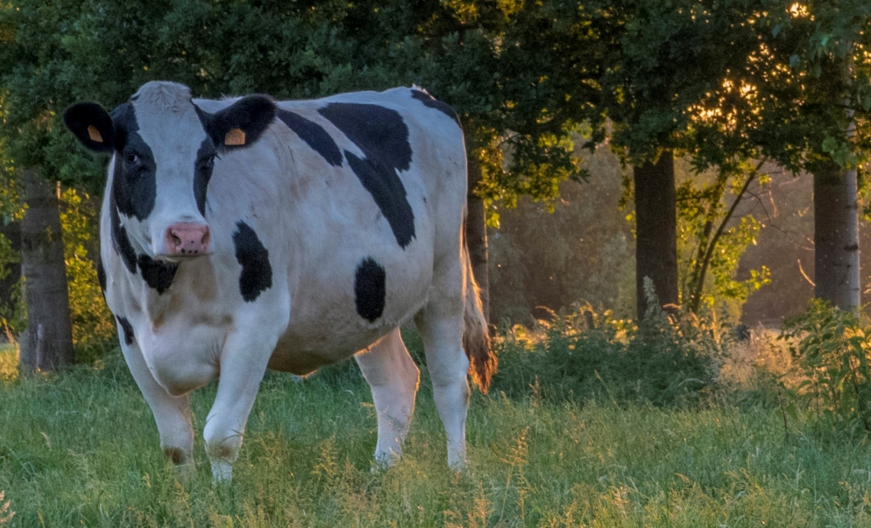
Questions?
Thank you for your attention
Inge.Van.Oost@scarlet.be
Let me know if I can help (mobile +32 478 65 20 21)

